Slide 1

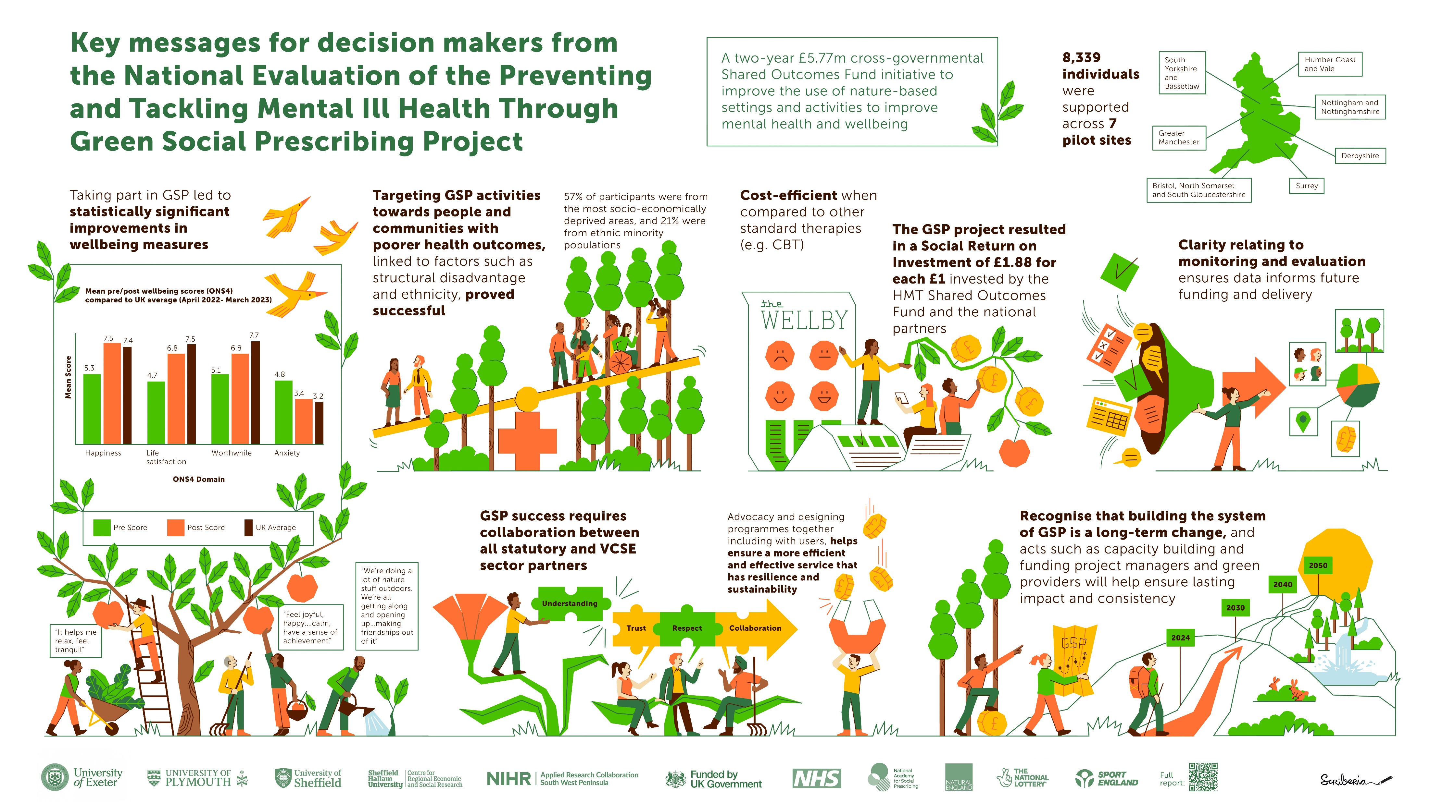
National Evaluation of the Preventing and Tackling Mental Ill Health through Green Social Prescribing Project
Short Infographic slide deck
Set 1. Information for commissioners
Set 2. What is green social prescribing?
Haywood, A. et al. National Evaluation of the Preventing and Tackling Mental Ill Health through Green Social Prescribing Project. 2024. Defra.

Slide 2
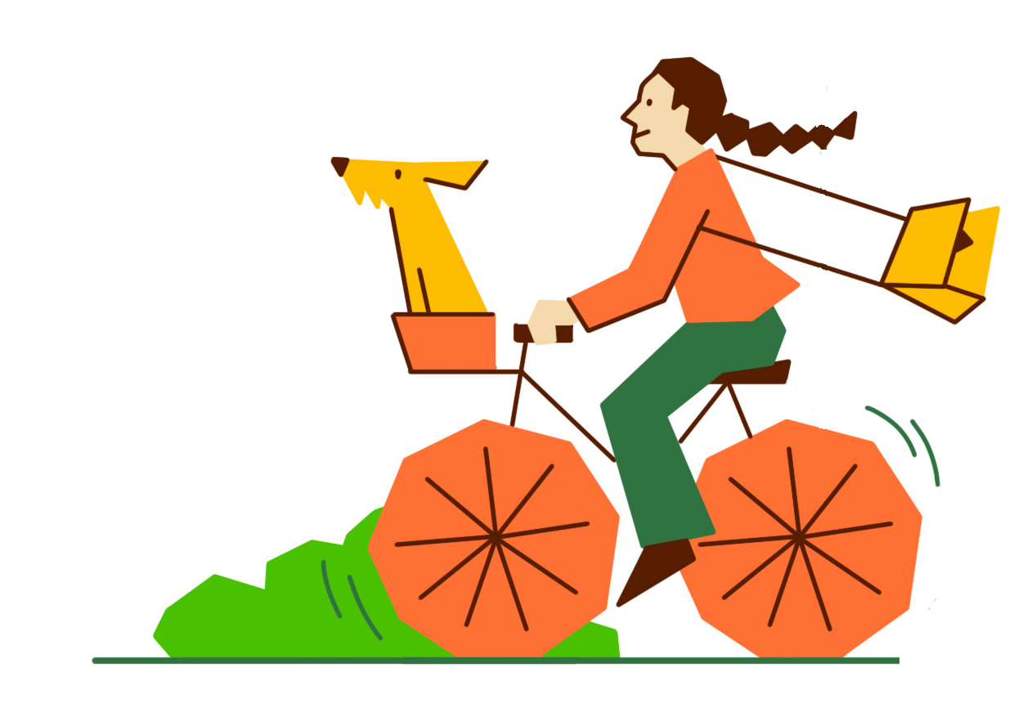
Haywood, A. et al. National Evaluation of the Preventing and Tackling Mental Ill Health through Green Social Prescribing Project. 2024. Defra.
National Evaluation of the Preventing and Tackling Mental Ill Health through Green Social Prescribing Project
Set 1. Information for commissioners

Slide 3


Slide 4
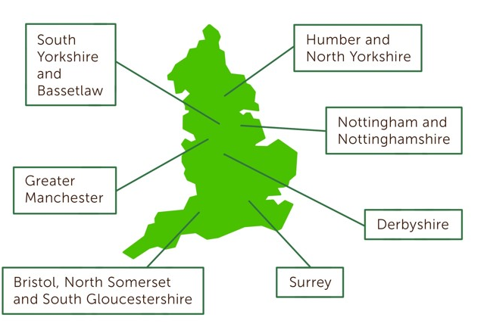


Haywood, A. et al. National Evaluation of the Preventing and Tackling Mental Ill Health through Green Social Prescribing Project. 2024. Defra.
About the Green Social Prescribing Test and Learn programme
A two year £5.77m cross government Shared Outcomes Fund initiative to improve the use of nature-based settings and activities to improve mental health and wellbeing
8,339 individuals were supported across seven sites in England

Slide 5
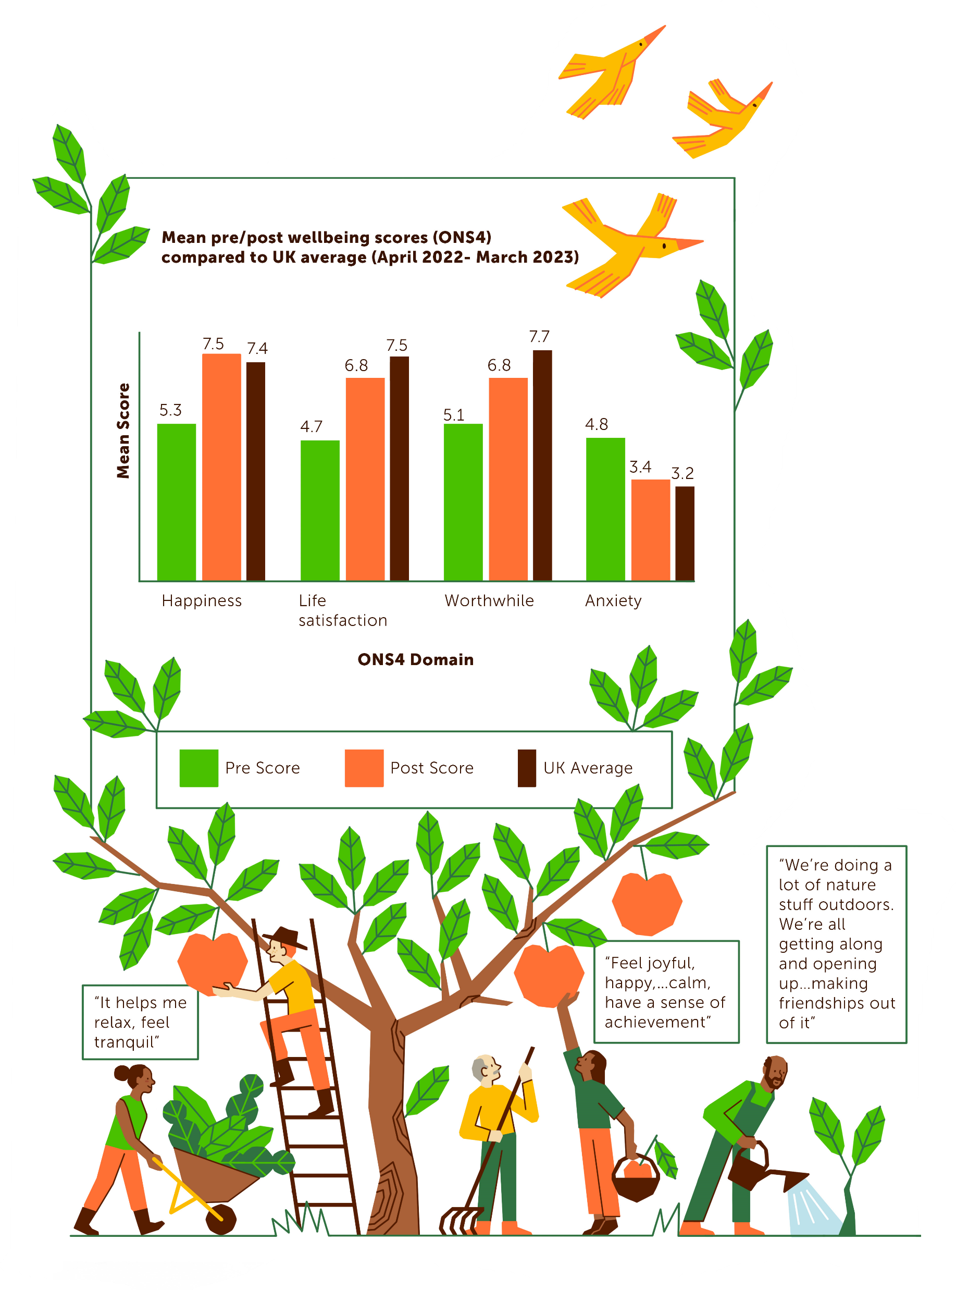

Haywood, A. et al. National Evaluation of the Preventing and Tackling Mental Ill Health through Green Social Prescribing Project. 2024. Defra.
Impacts of Green Social Prescribing
Taking part in green socially prescribed activities resulted in statistically significant improvements in wellbeing measures

Slide 6
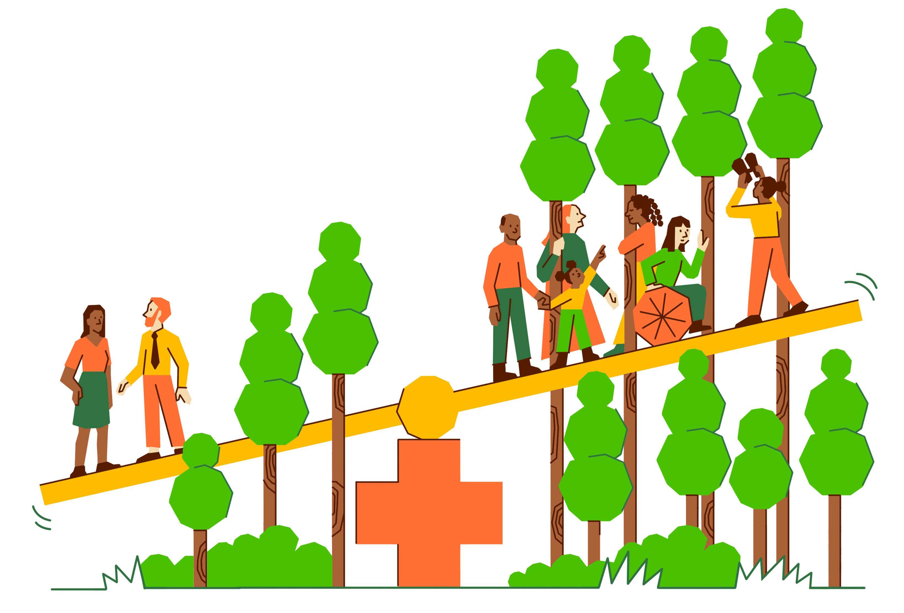
Haywood, A. et al. National Evaluation of the Preventing and Tackling Mental Ill Health through Green Social Prescribing Project. 2024. Defra.
Impacts of Green Social Prescribing
Targeting green social prescribed activities towards people and communities with poorer health outcomes, linked to factors such as structural disadvantage and ethnicity, proved successful
57% of participants were from the most socio-economically deprived areas, and 21% were from ethic minority populations

Slide 7
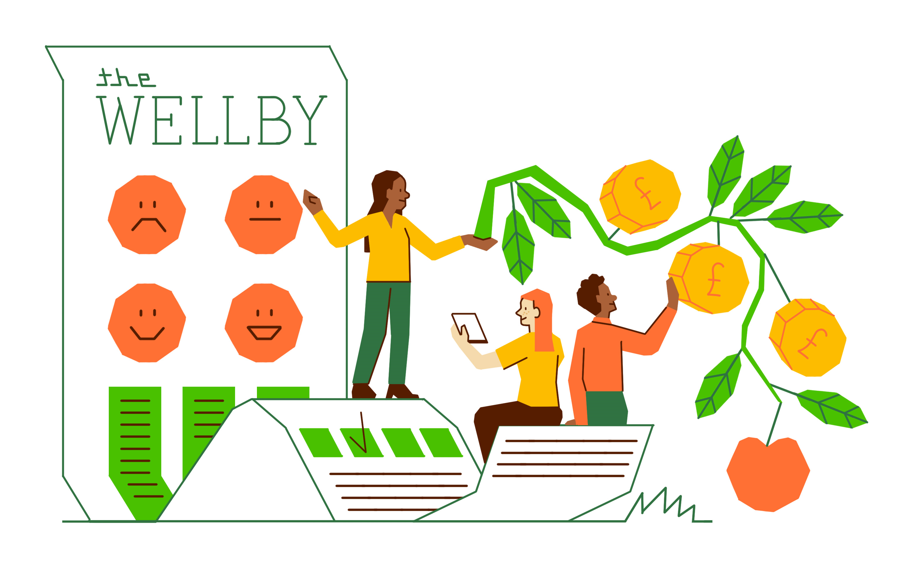
Haywood, A. et al. National Evaluation of the Preventing and Tackling Mental Ill Health through Green Social Prescribing Project. 2024. Defra.
Impacts of Green Social Prescribing
Green social prescribing was shown to be cost-efficient when compared to other standard therapies (e.g. CBT)
The GSP project resulted in a Social Return on Investment of £1.88 for each £1 invested

Slide 8
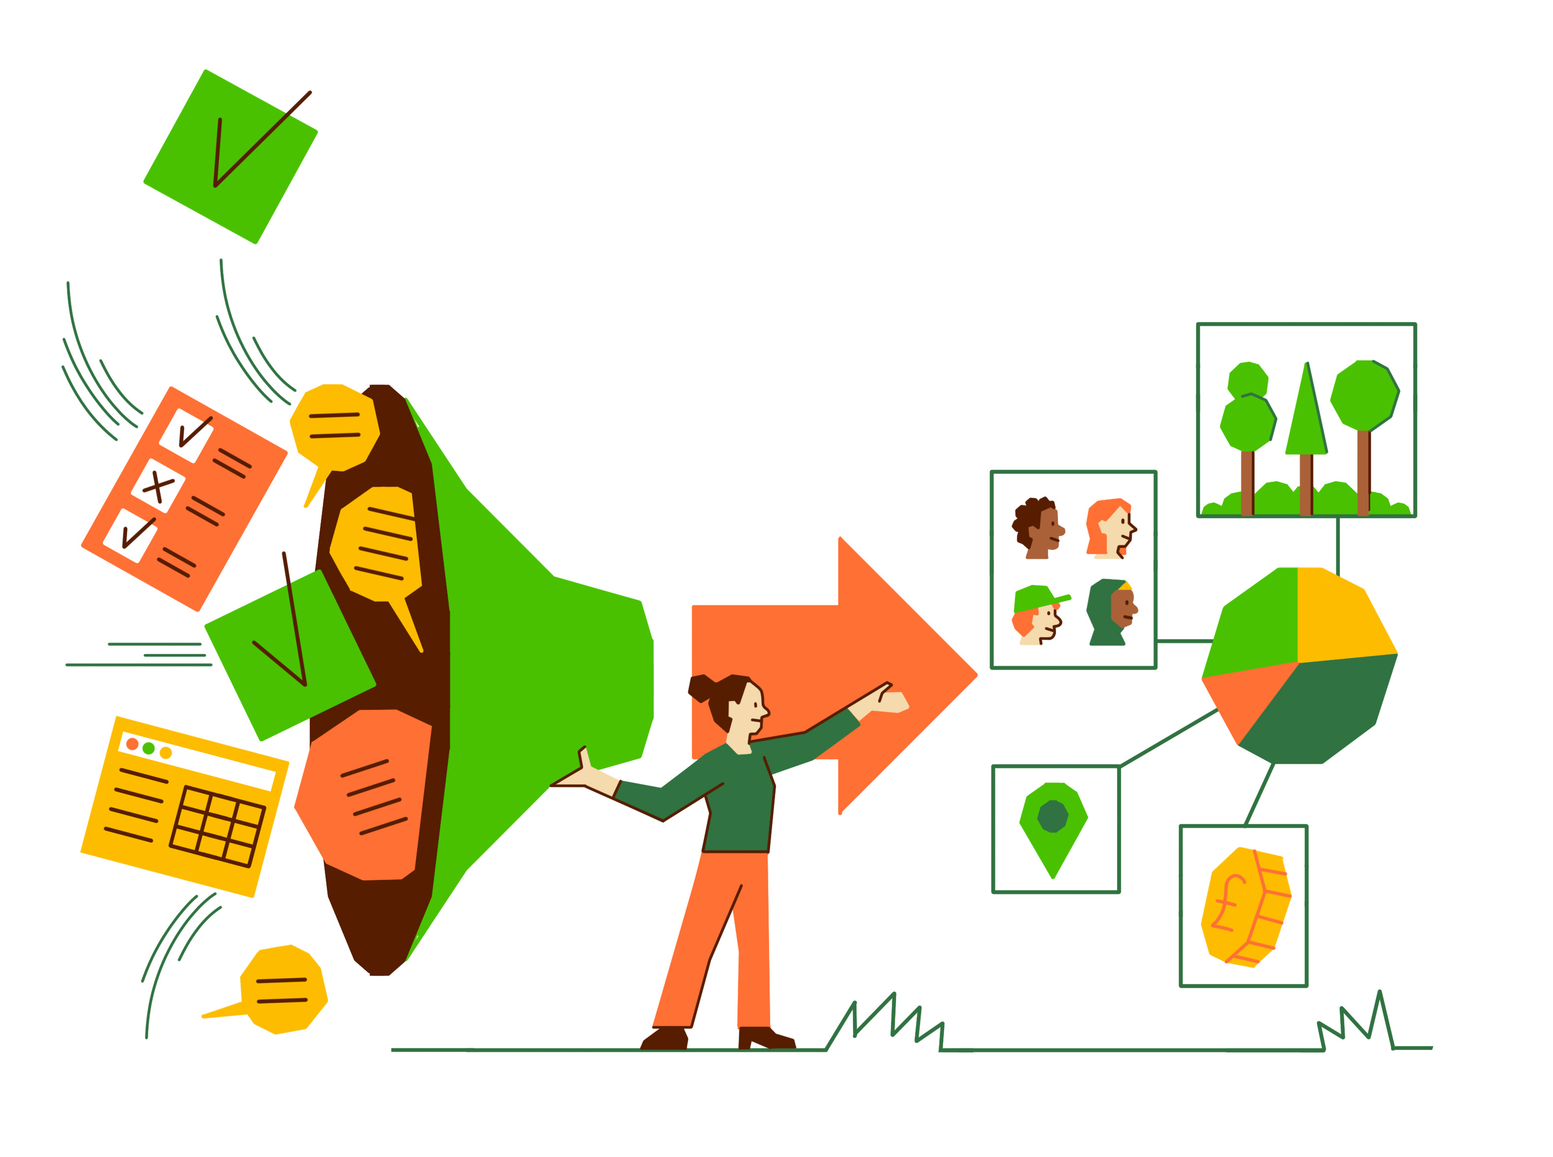
Haywood, A. et al. National Evaluation of the Preventing and Tackling Mental Ill Health through Green Social Prescribing Project. 2024. Defra.
Strengthening the Green Social Prescribing system
Clarity relating to monitoring and evaluation ensures data informs future funding and delivery

Slide 9
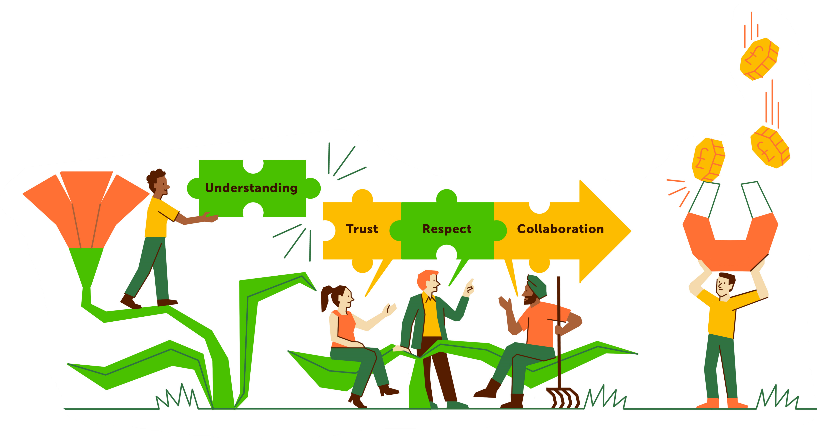
Haywood, A. et al. National Evaluation of the Preventing and Tackling Mental Ill Health through Green Social Prescribing Project. 2024. Defra.
Strengthening the Green Social Prescribing system
Green Social Prescribing success requires collaboration between all statutory and VCSE sector partners
Advocacy and designing programmes together, including with users, helps ensure a more efficient and effective service that has resilience and sustainability

Slide 10
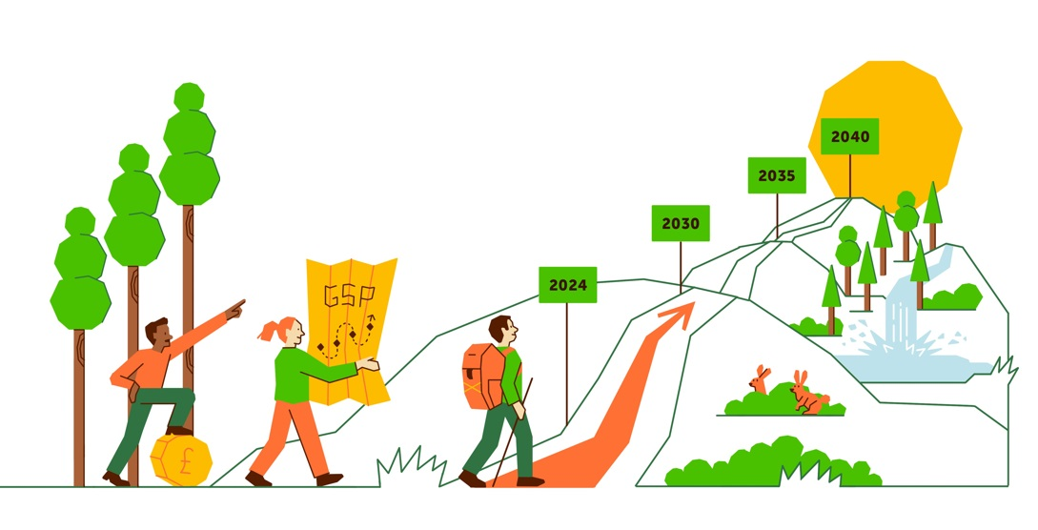
Haywood, A. et al. National Evaluation of the Preventing and Tackling Mental Ill Health through Green Social Prescribing Project. 2024. Defra.
Strengthening the Green Social Prescribing system
Recognise that building the system of Green Social Prescribing is a long-term change
Acts such as capacity building and funding project managers and green providers will help ensure lasting impact and consistency

Slide 11


Haywood, A. et al. National Evaluation of the Preventing and Tackling Mental Ill Health through Green Social Prescribing Project. 2024. Defra.
National Evaluation of the Preventing and Tackling Mental Ill Health through Green Social Prescribing Project
Set 2. What is green social prescribing?

Slide 12
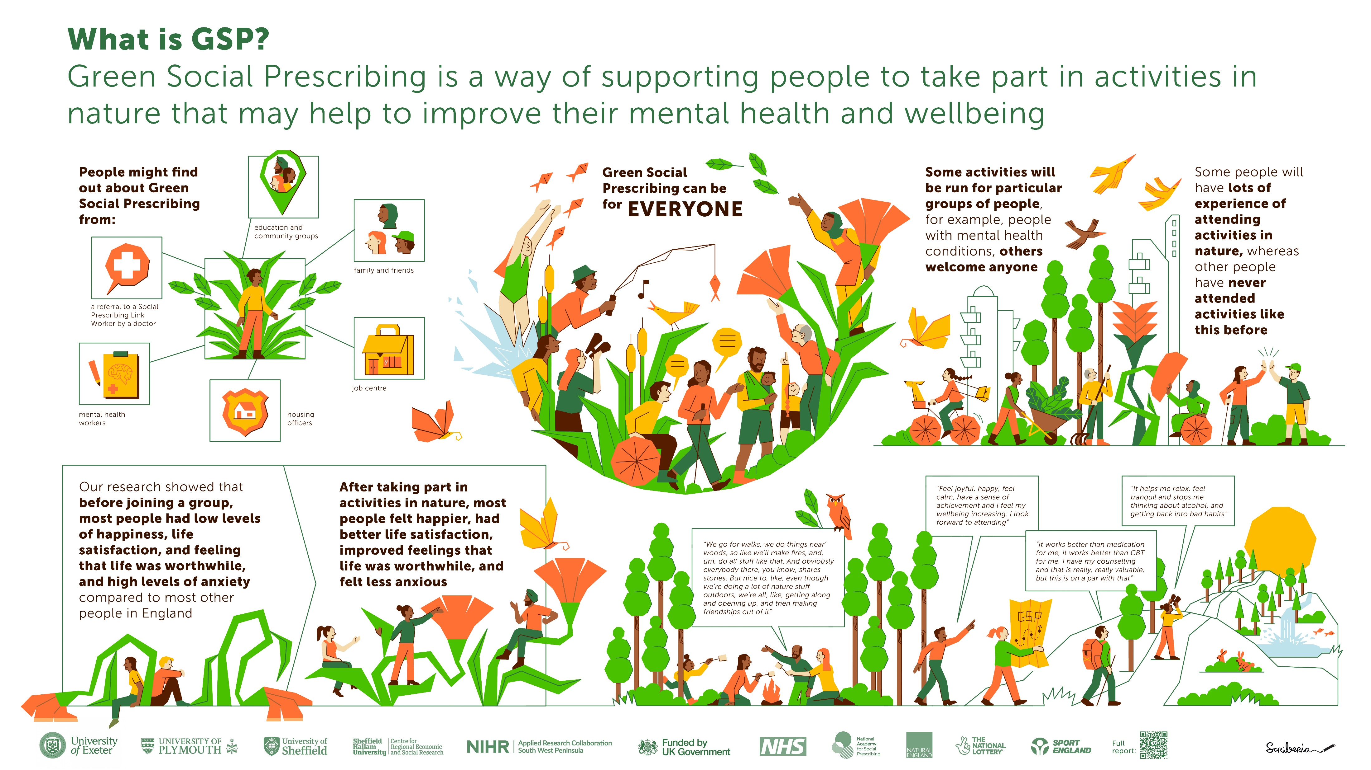

Slide 13
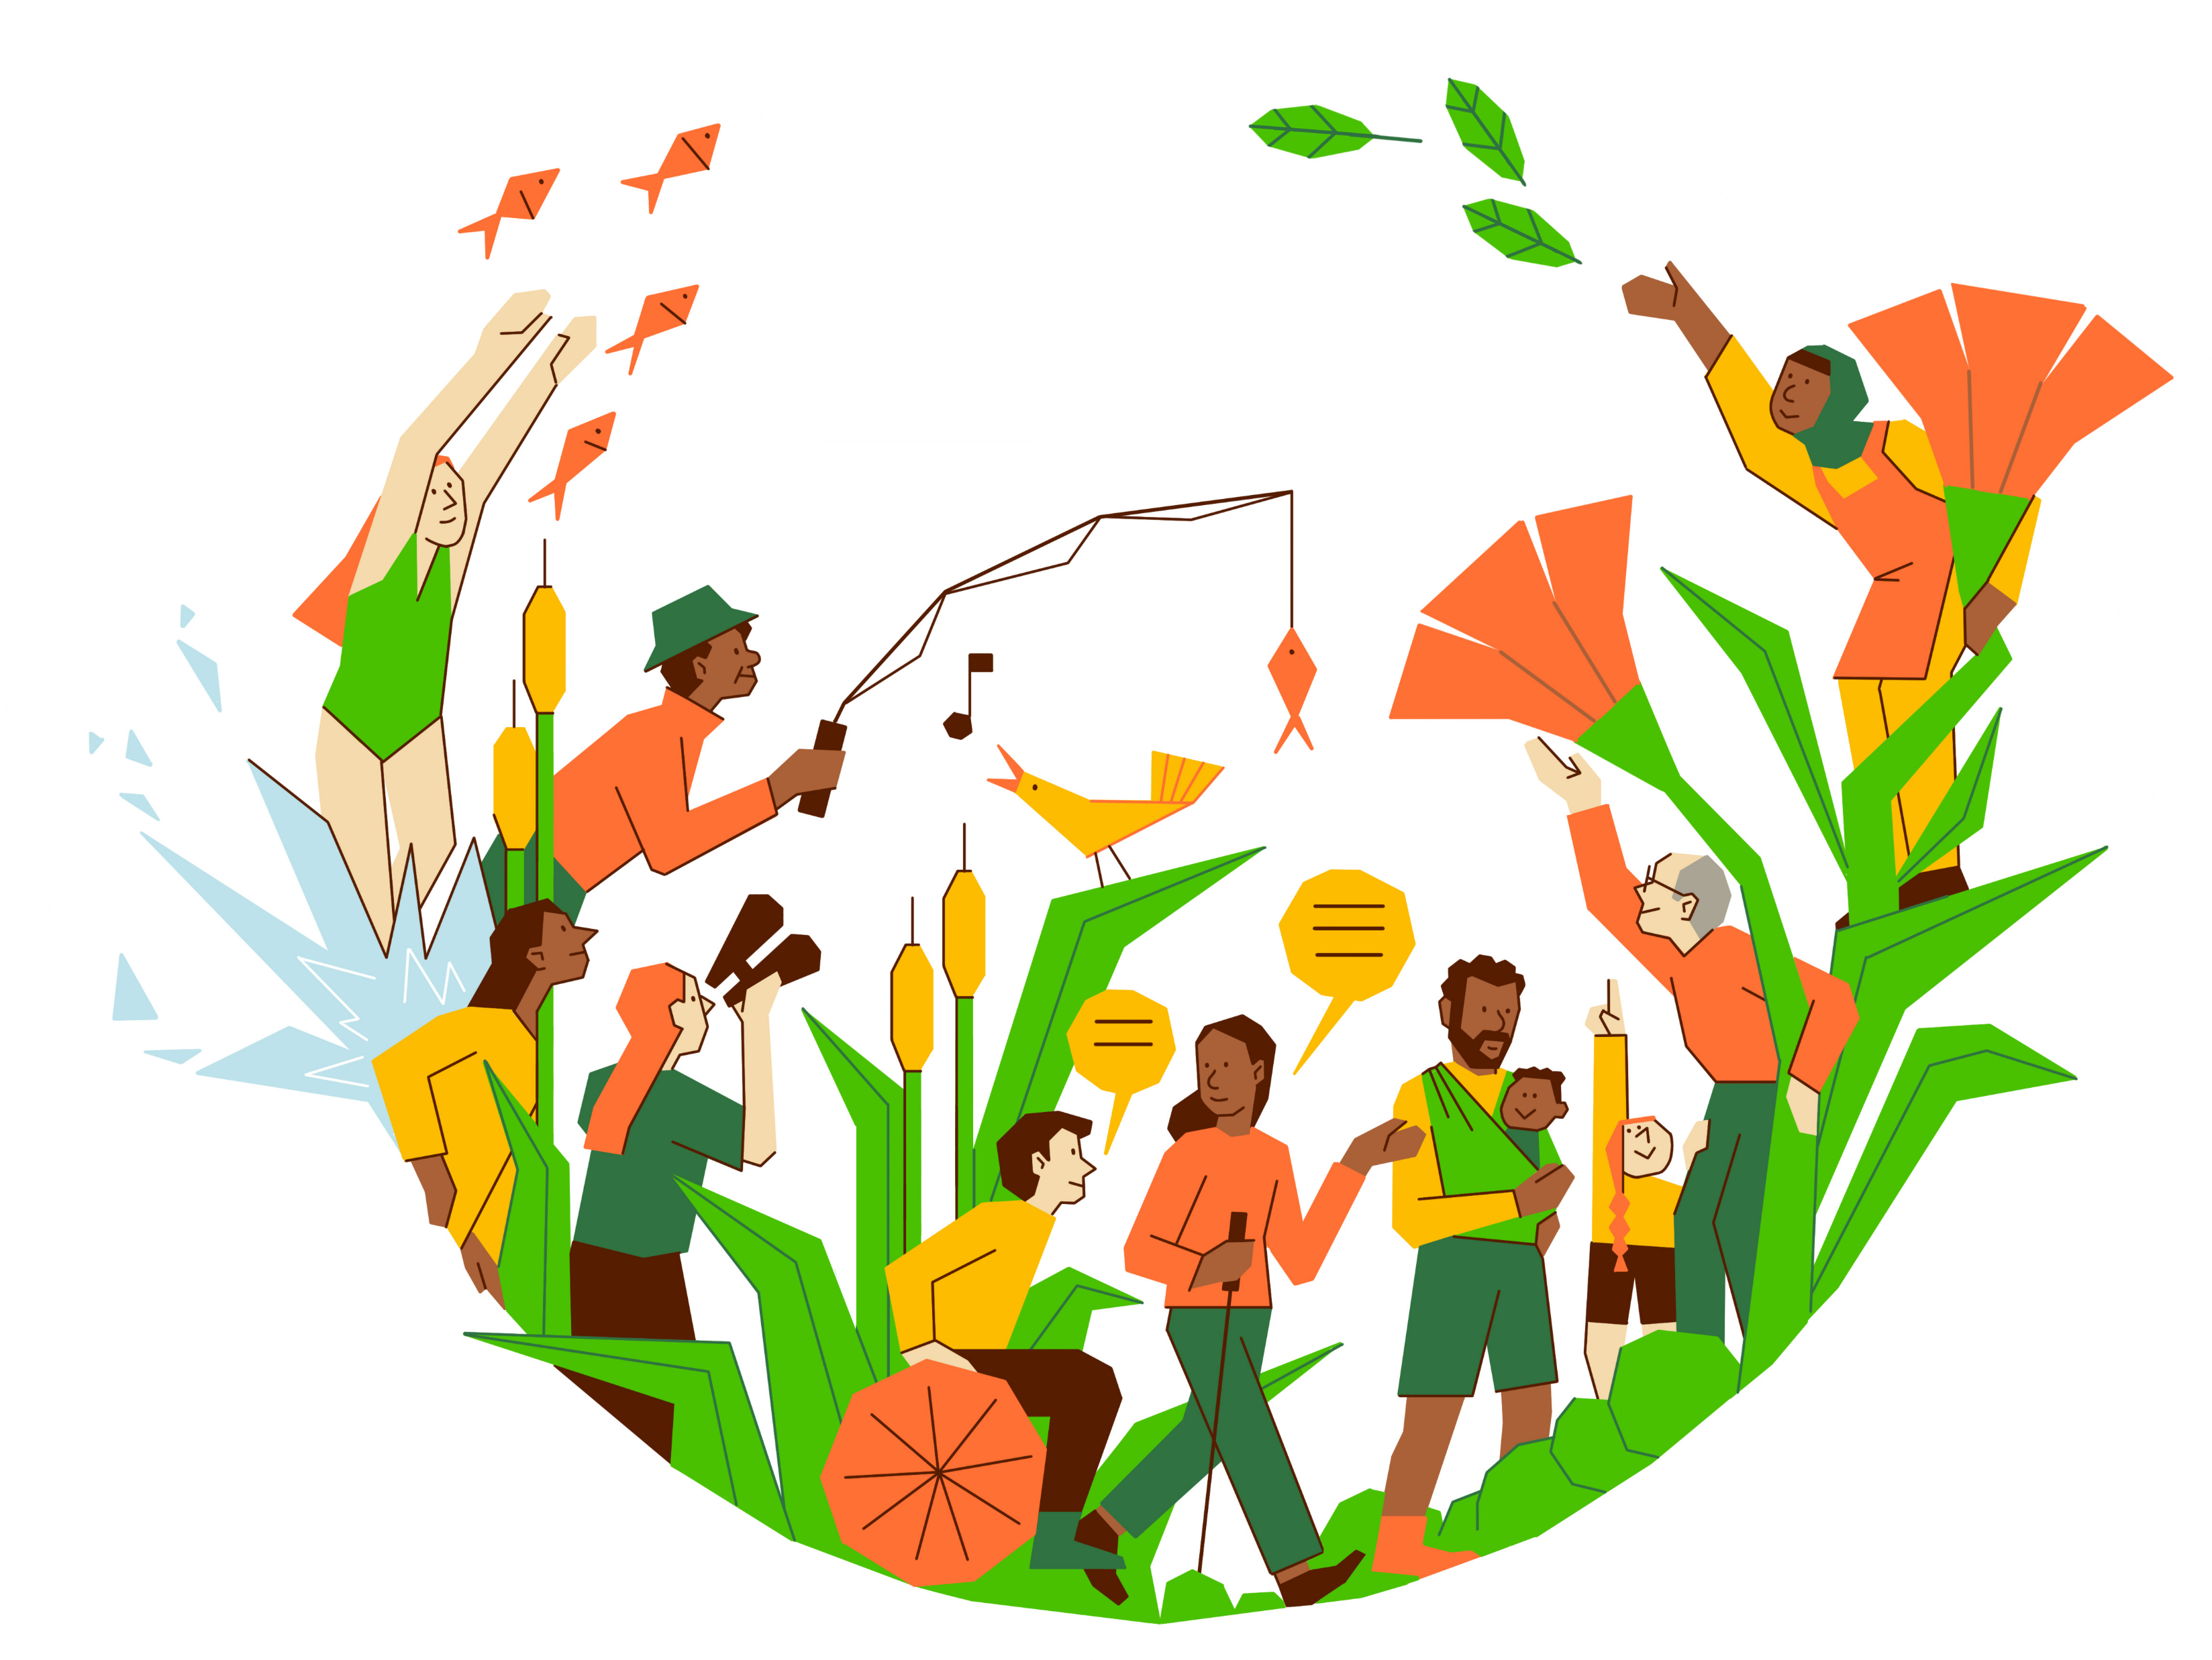
Haywood, A. et al. National Evaluation of the Preventing and Tackling Mental Ill Health through Green Social Prescribing Project. 2024. Defra.
Green social prescribing can be for EVERYONE

Slide 14
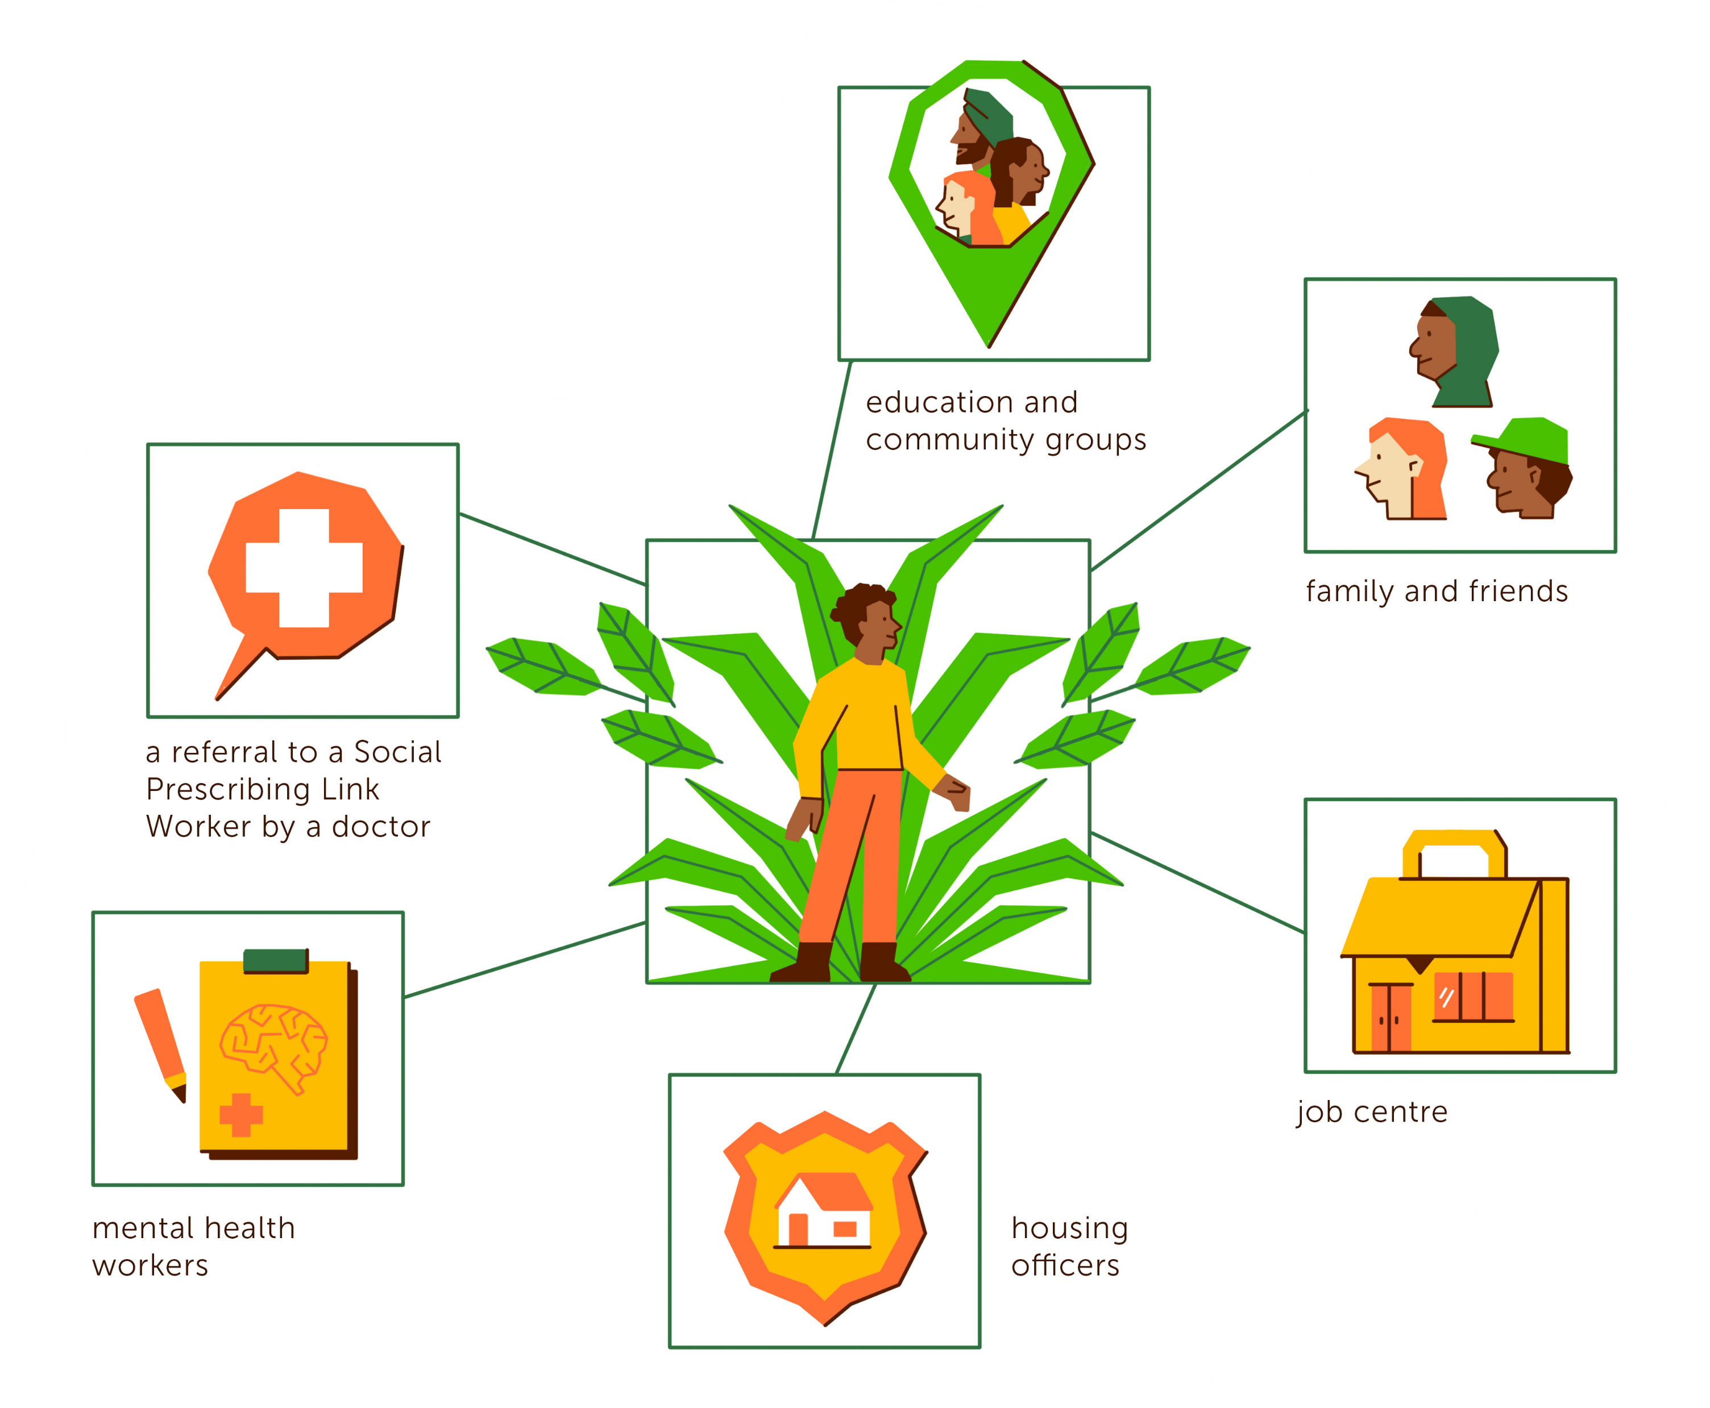
Haywood, A. et al. National Evaluation of the Preventing and Tackling Mental Ill Health through Green Social Prescribing Project. 2024. Defra.
How do people get to take part in green social prescribing?
People might find out about Green Social Prescribing from:

Slide 15
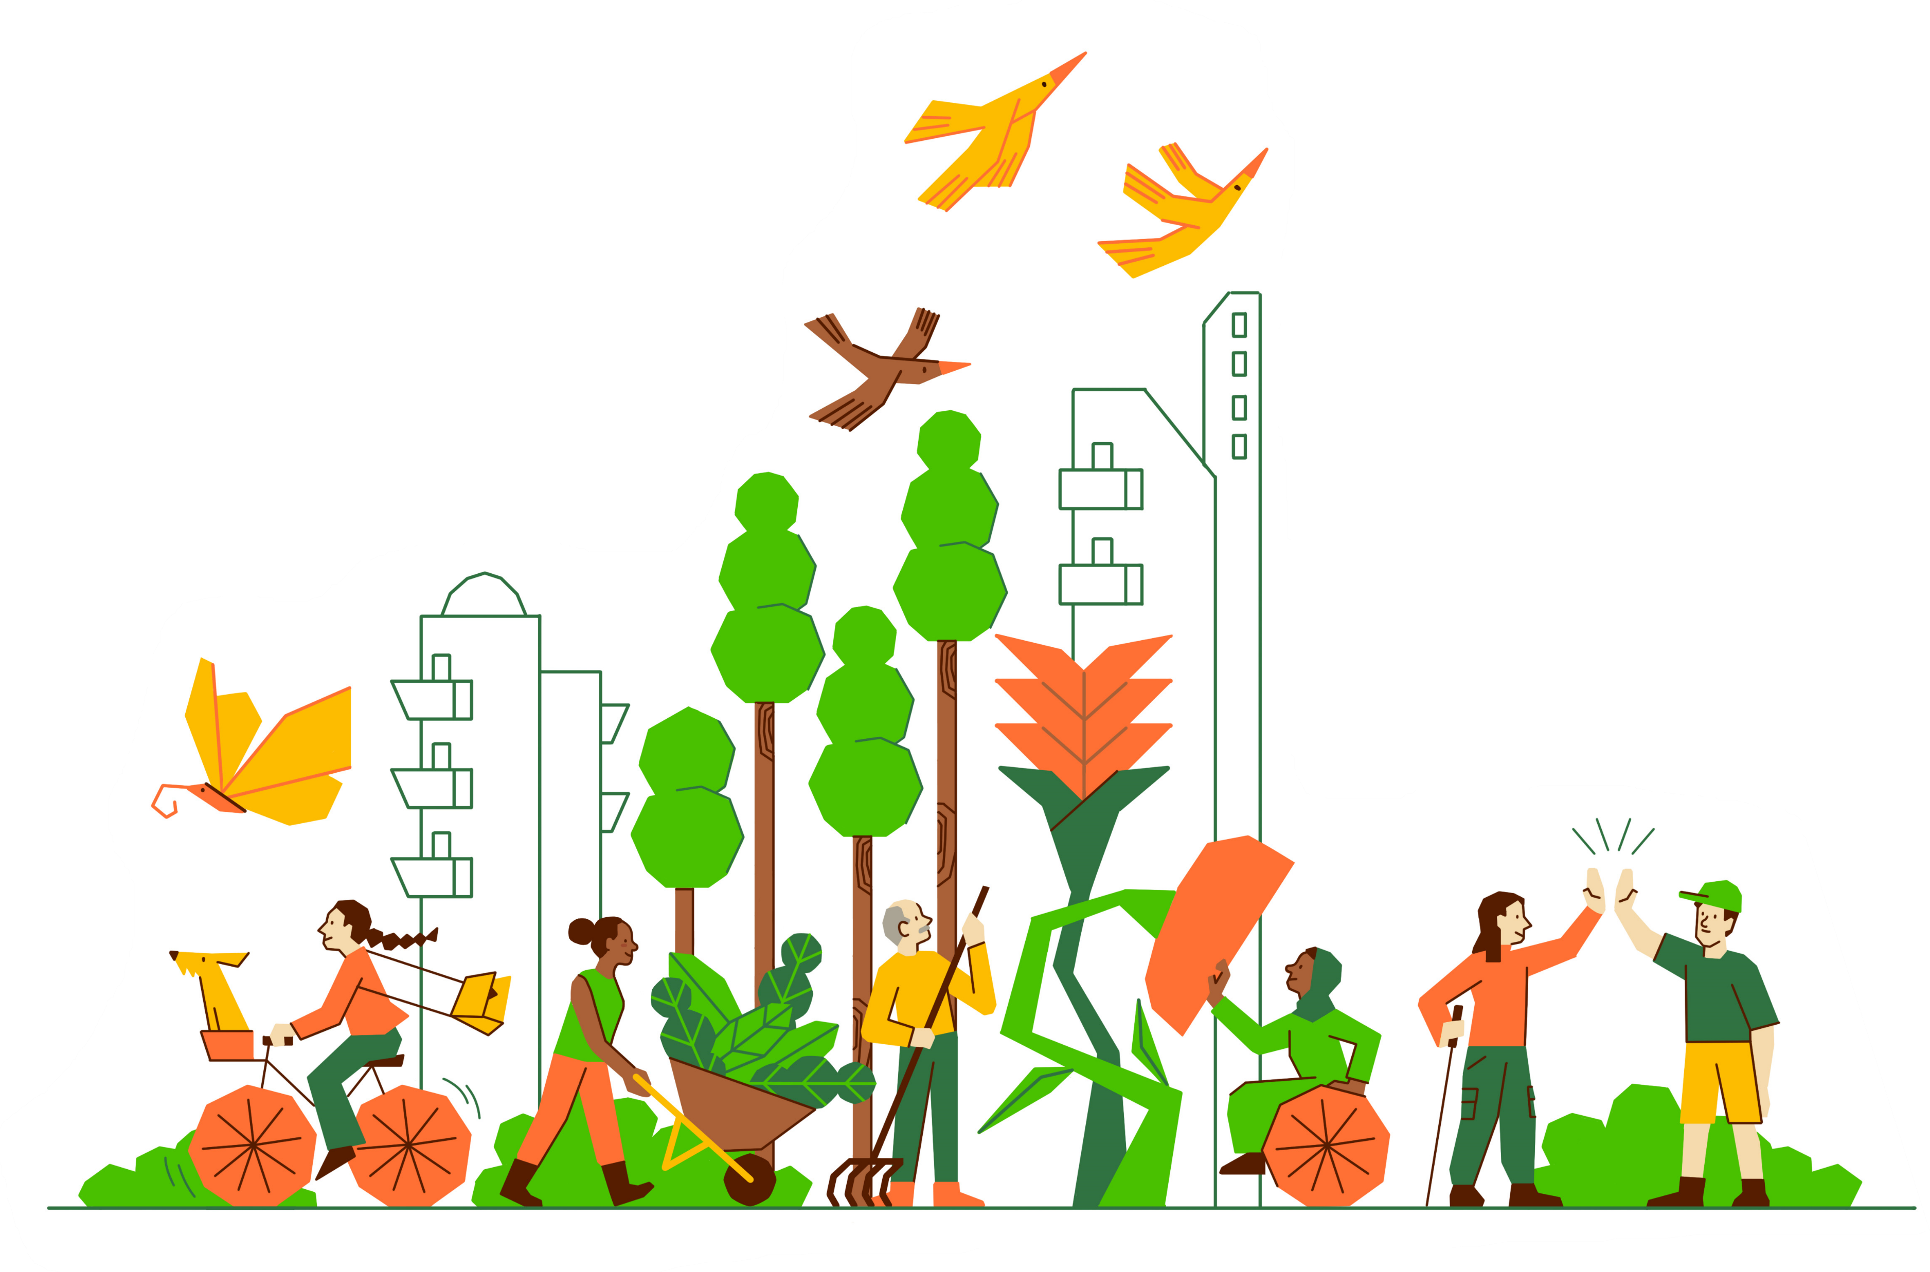
Haywood, A. et al. National Evaluation of the Preventing and Tackling Mental Ill Health through Green Social Prescribing Project. 2024. Defra.
What kinds of people do green social prescribing?
Some people will have lots of experience attending activities in natures, other people have never attended activities like this before
Some activities will be run for particular groups of people, for example people with mental health conditions, others welcome everyone

Slide 16
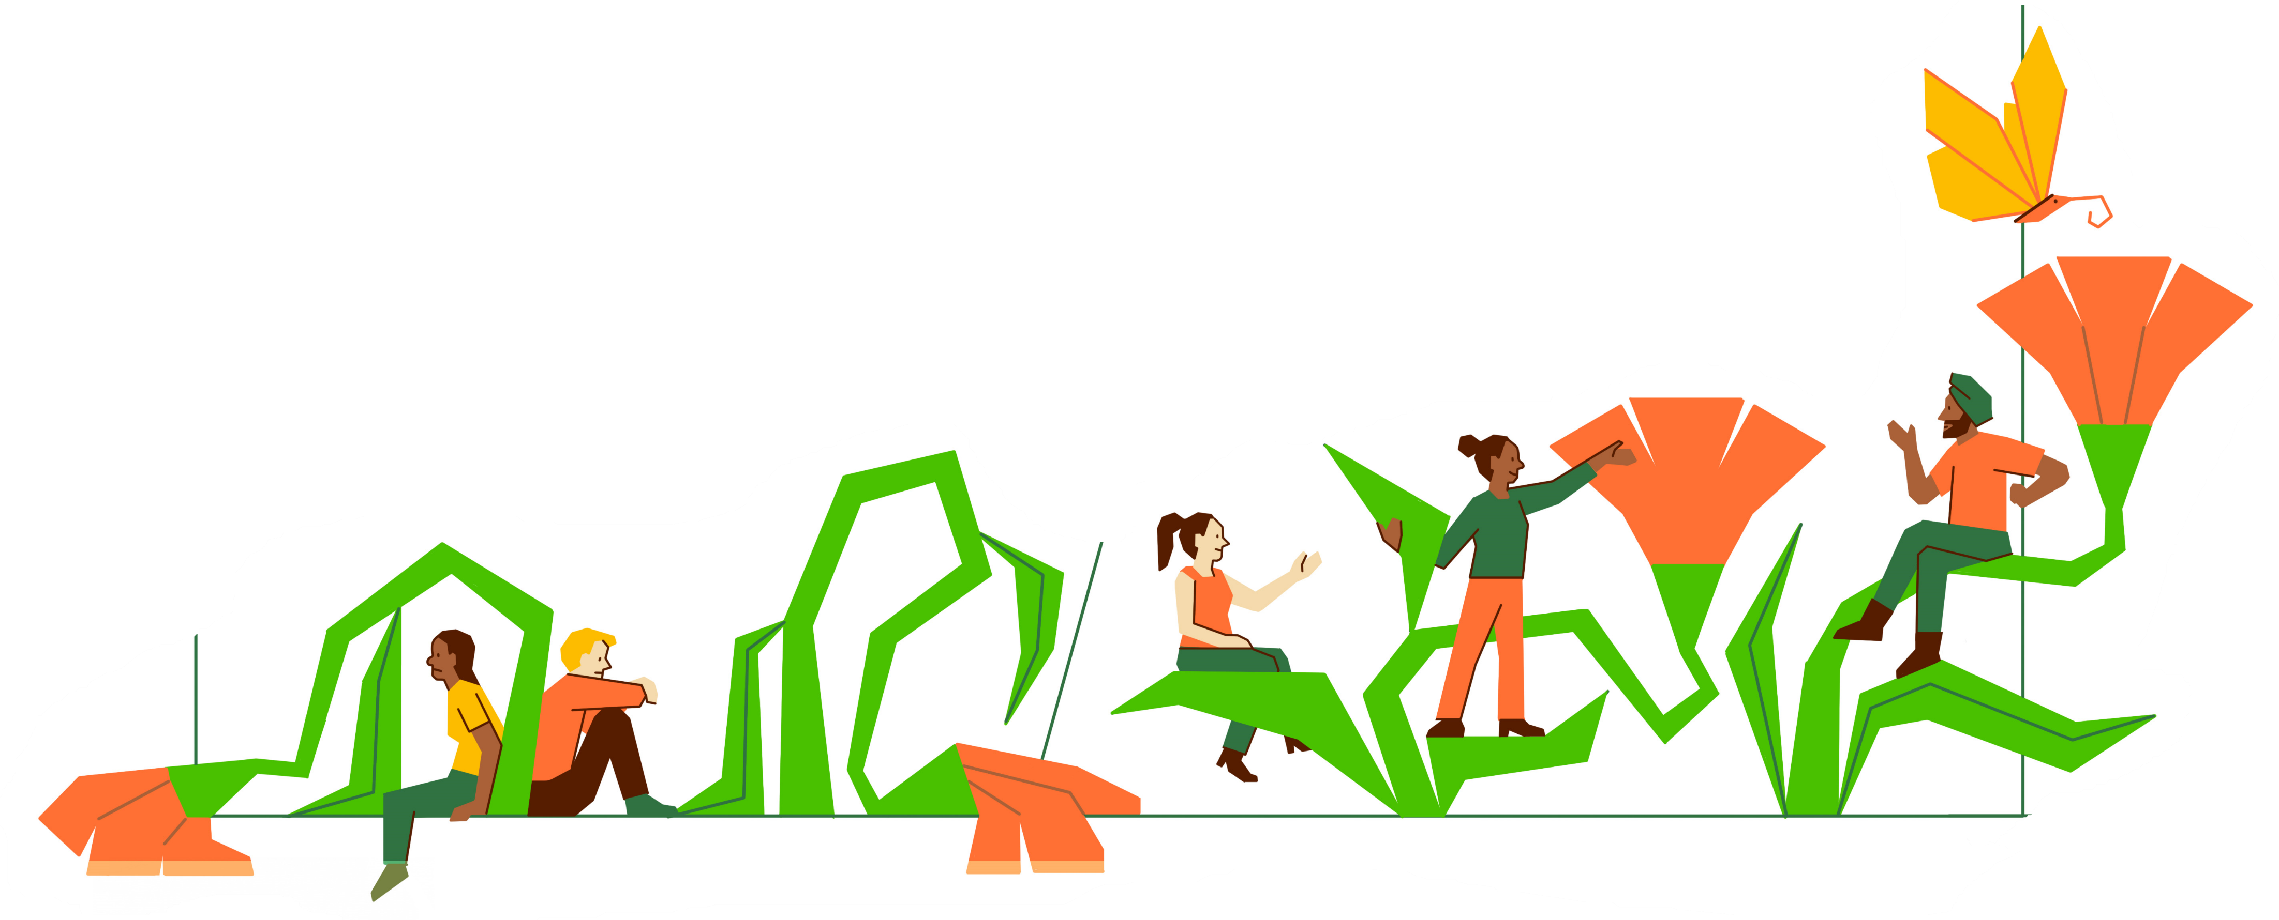
Haywood, A. et al. National Evaluation of the Preventing and Tackling Mental Ill Health through Green Social Prescribing Project. 2024. Defra.
How does green social prescribing help people?
Our research showed that before joining a group most people had low levels of happiness, life satisfaction, and feeling that life was worthwhile and high levels of anxiety compared to most other people in England
After taking part most people felt happier, had better life satisfaction, improved feelings that life was worthwhile and felt less anxious

Slide 17


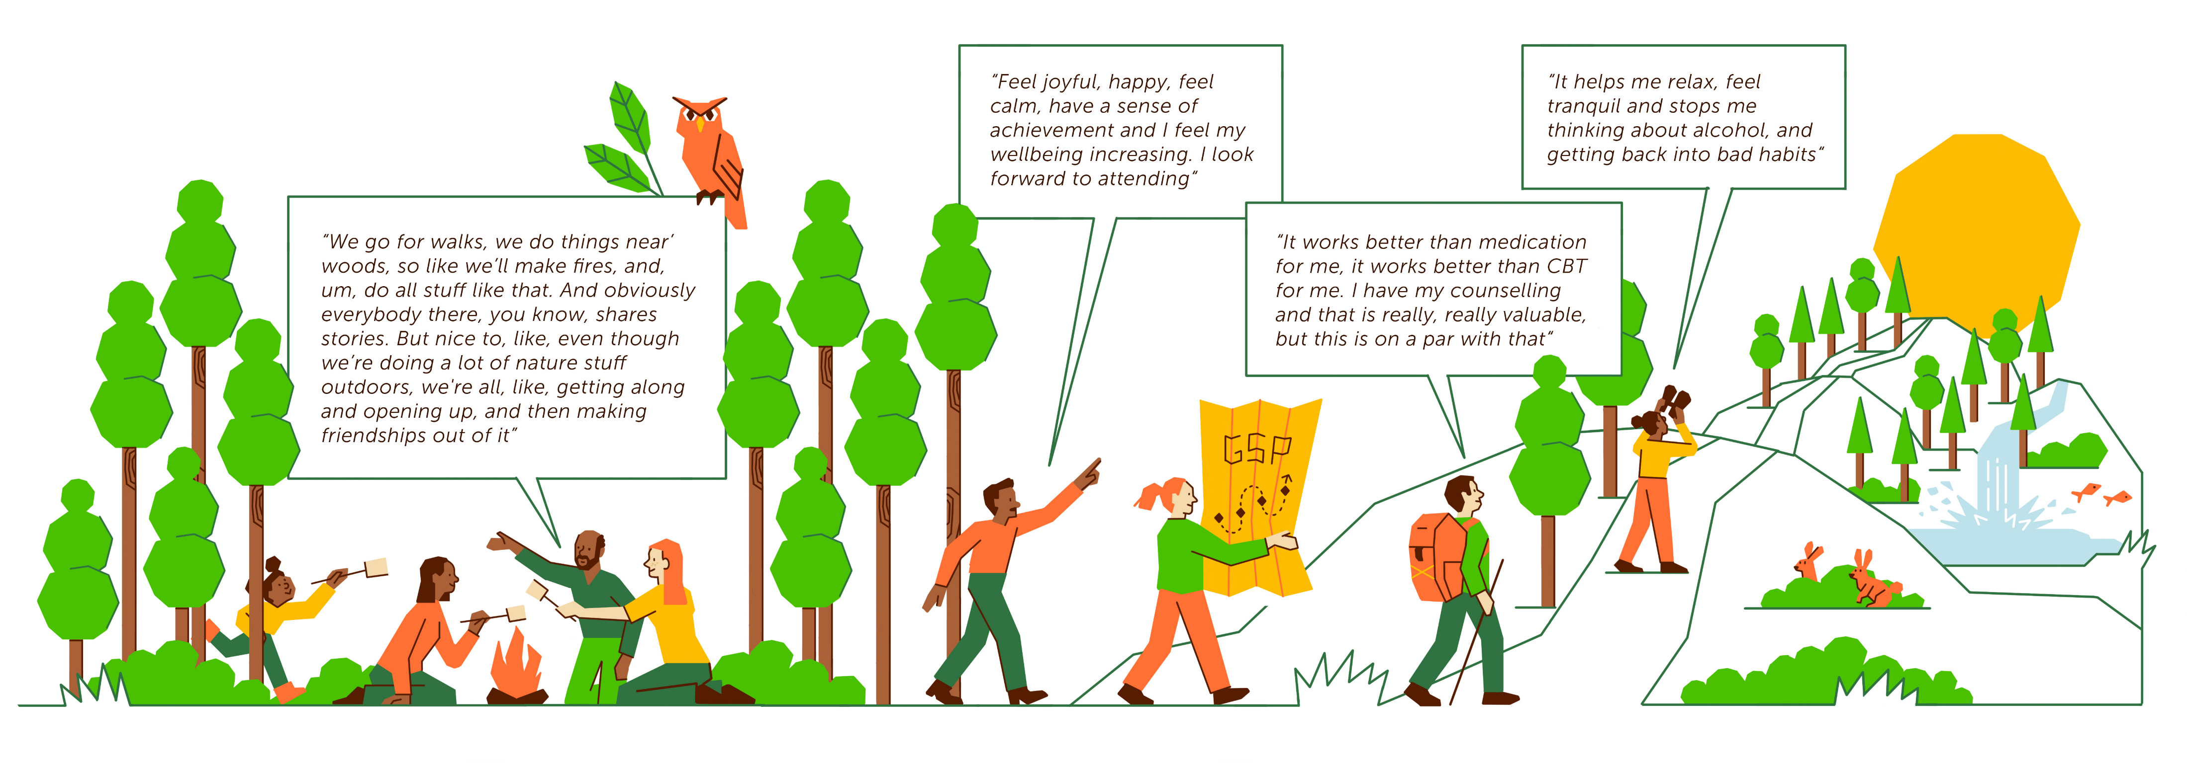
Haywood, A. et al. National Evaluation of the Preventing and Tackling Mental Ill Health through Green Social Prescribing Project. 2024. Defra.
How did other people feel that green social prescribing helped them?

