Slide 1


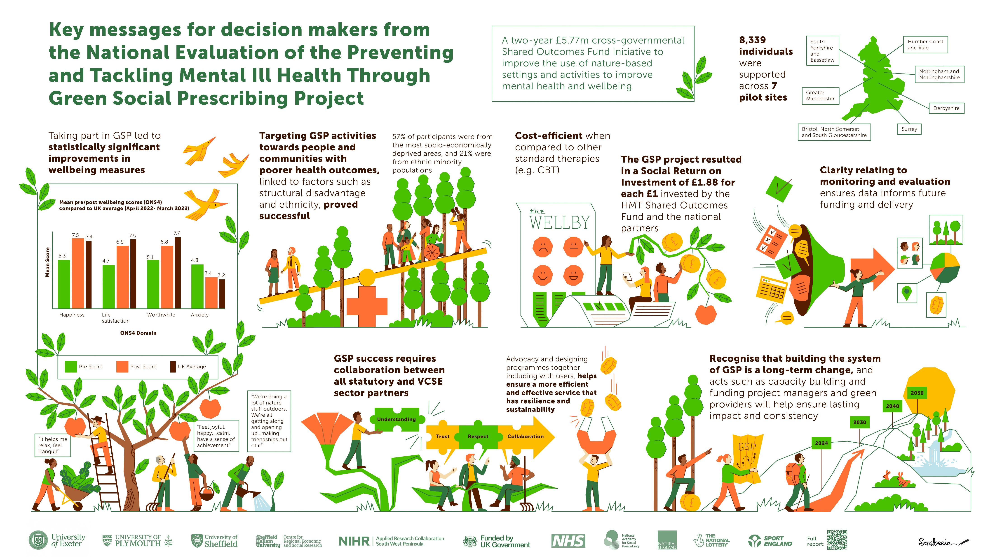
Haywood, A. et al. National Evaluation of the Preventing and Tackling Mental Ill Health through Green Social Prescribing Project. 2024. Defra.
National Evaluation of the Preventing and Tackling Mental Ill Health through Green Social Prescribing Project

Slide 2



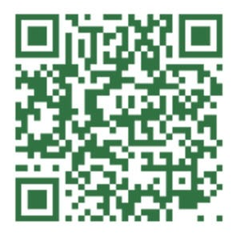


This slide deck describes the results of the National Evaluation of the Preventing and Tackling Mental Ill Health through Green Social Prescribing Project
Contents:
Haywood, A. et al. National Evaluation of the Preventing and Tackling Mental Ill Health through Green Social Prescribing Project. 2024. Defra.
To access the full report follow this QR code or visit https://randd.defra.gov.uk/ProjectDetails?ProjectId=20772
What is Green Social Prescribing
The Preventing and Tackling Mental Ill Health through Green Social Prescribing Project
Reach of the Green Social Prescribing Project
Outcomes for people with mental health needs
Understanding the value for money of the Green Social Prescribing Project
Key learning about how to scale and spread Green Social Prescribing
Reflections from the Green Social Prescribing National Partnership
Evaluation methods, reference and disclaimer statement

Slide 3


Haywood, A. et al. National Evaluation of the Preventing and Tackling Mental Ill Health through Green Social Prescribing Project. 2024. Defra.
What is Green Social Prescribing?
Green Social Prescribing (GSP) is the practice of supporting people to engage in nature-based activities to tackle and prevent mental ill health.
Social Prescribing Link Workers, and other trusted professionals in allied roles, connect people to community groups and agencies for practical and emotional support, based on a ‘what matters to you’ conversation.
There are many different types of nature-based activities and therapies that people may reach through a social prescription. Typical activities include: conservation activities; wilderness focused; horticulture and gardening; care farming; exercise and sport focused; creativity focused; talking therapies in the outdoors; and alternative therapies in the outdoors

Slide 4
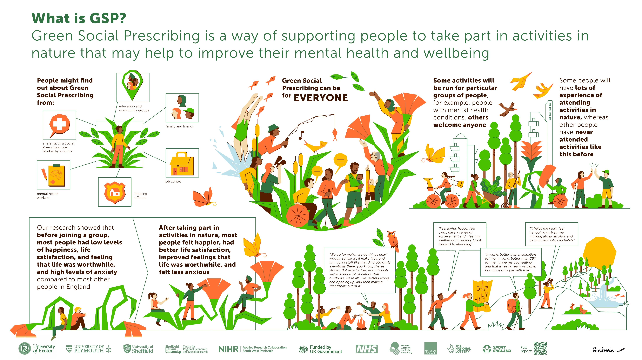

Slide 5
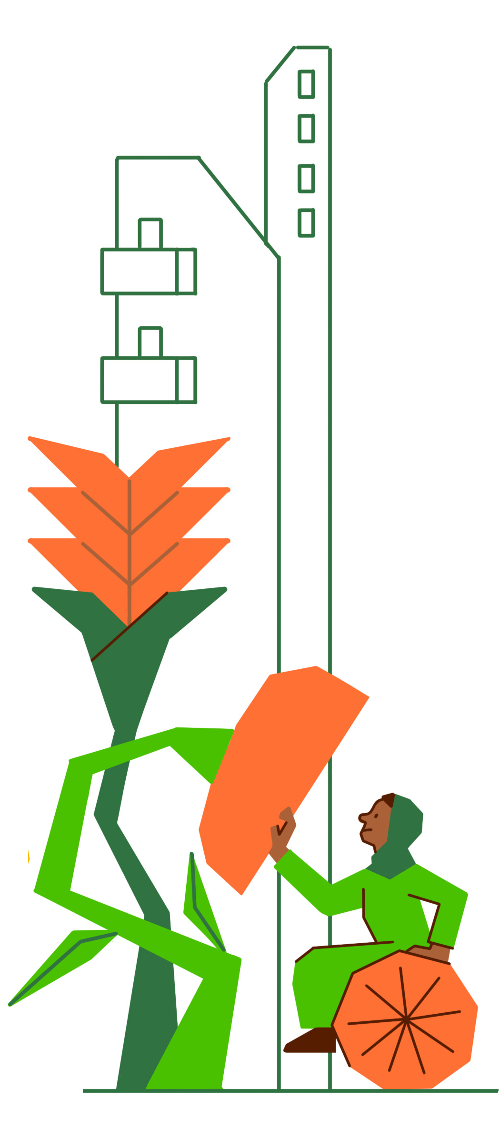
Haywood, A. et al. National Evaluation of the Preventing and Tackling Mental Ill Health through Green Social Prescribing Project. 2024. Defra.
The Preventing and Tackling Mental Ill Health through Green Social Prescribing Project
The Preventing and Tackling Mental Ill Health through Green Social Prescribing Project (GSP Project), was a two year £5.77 million cross-governmental initiative focused on how to improve the use of nature-based settings and activities to promote wellbeing and improve mental health (£4.27M from HM Treasury’s Shared Outcomes Fund and £1.50M from various central government departments and external agencies).
Partners included: Department of Health and Social Care, Department for Environment, Food and Rural Affairs, Natural England, NHS England, NHS Improvement, Public Health England, Sport England, Department for Levelling Up, Housing & Communities and the National Academy for Social Prescribing.

Slide 6
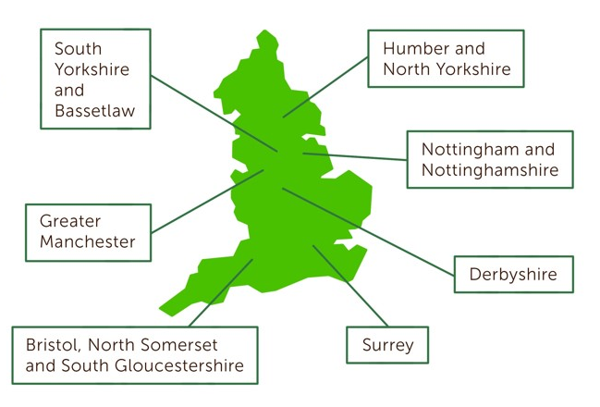
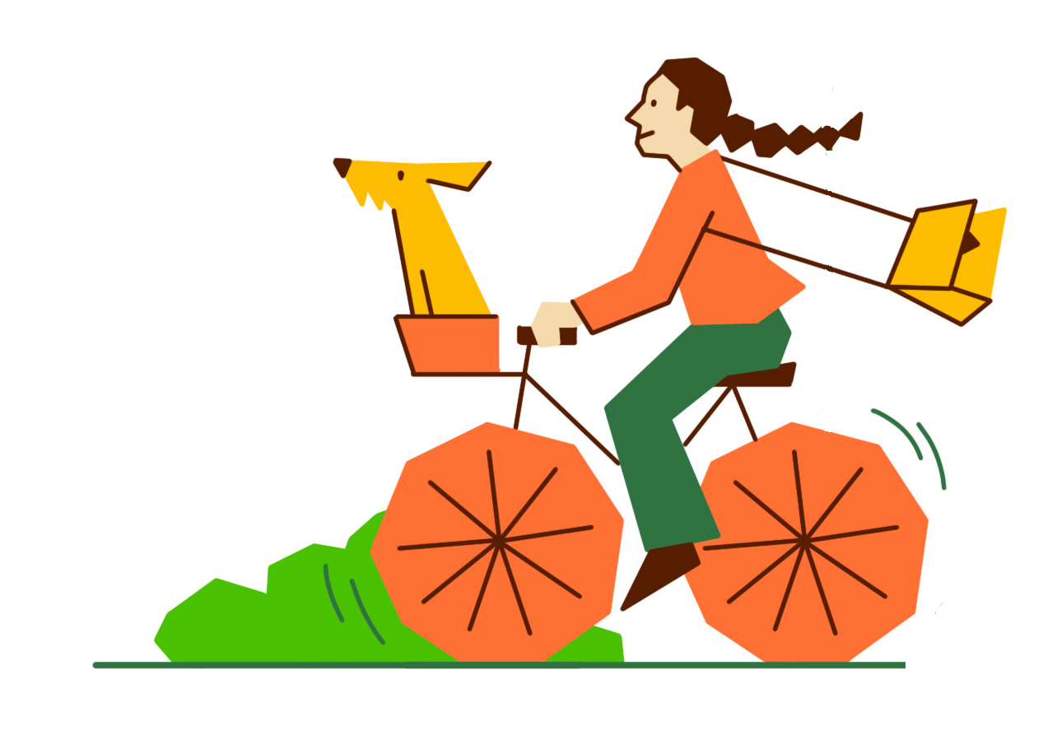

Haywood, A. et al. National Evaluation of the Preventing and Tackling Mental Ill Health through Green Social Prescribing Project. 2024. Defra.
The Preventing and Tackling Mental Ill Health through Green Social Prescribing Project
The aims of the GSP project were to:
Improve mental health outcomes.
Reduce health inequalities.
Reduce demand on the health and social care system. Develop best practice in making green social activities more resilient and accessible

Slide 7


Slide 8


Haywood, A. et al. National Evaluation of the Preventing and Tackling Mental Ill Health through Green Social Prescribing Project. 2024. Defra.
Reach of the Green Social Prescribing Project
Through the Green Social Prescribing Project 8,339 people with mental health needs were supported to access nature-based activities accross the seven Test and Learn sites
The GSP Project was able to reach a broader range of people compared to many other social prescribing initiatives, including:
children and young people aged under 18
ethnic minority populations (21%)
people from socio-economically deprived areas (57% in IMD deciles 1-3).

Slide 9



Haywood, A. et al. National Evaluation of the Preventing and Tackling Mental Ill Health through Green Social Prescribing Project. 2024. Defra.
Outcomes for people with mental health needs
Across the seven pilots there was a statistically significant improvement in wellbeing for each of the ONS4 wellbeing domains after accessing nature-based activities through the GSP Project
Happiness increased from an average of 5.3 to 7.5
Life satisfaction increased from an average of 4.7 to 6.8
Feeling that life is worthwhile increased from an average of 5.1 to 6.8
Levels of anxiety reduced from an average of 4.8 to 3.4
Prior to accessing nature-based activities participants’ happiness, anxiety, life satisfaction and feeling that their life was worthwhile was much worse than the national average
After accessing nature-based activities this had improved so that their happiness and anxiety was in line with the national average, and the gap to the national average for levels of life satisfaction and feeling that their life was worthwhile had narrowed significantly

Slide 10
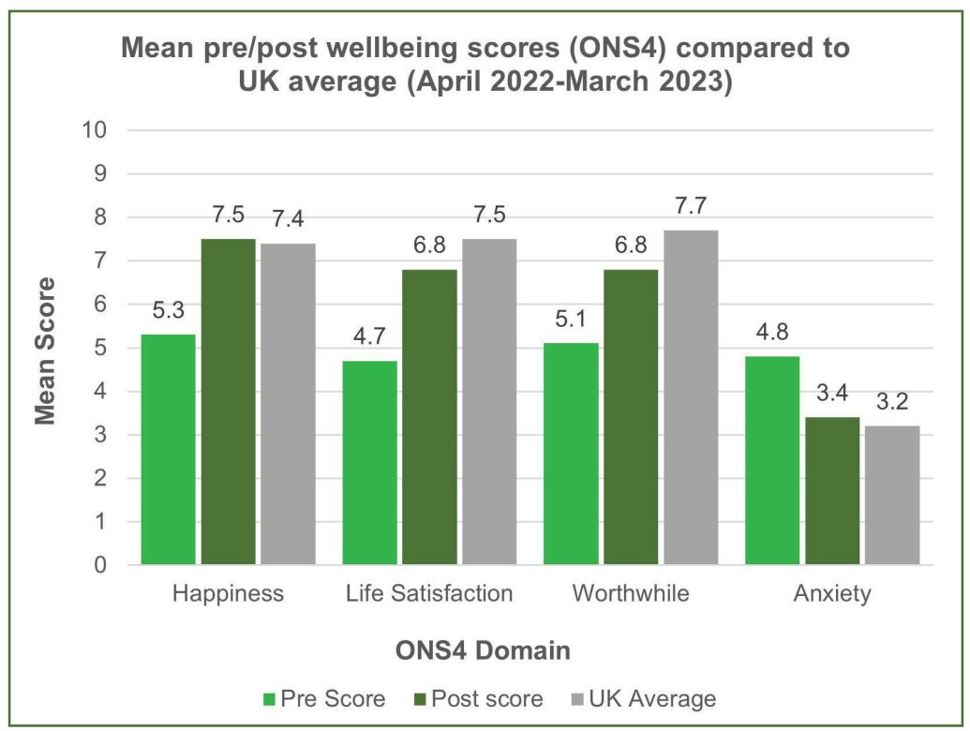
Haywood, A. et al. National Evaluation of the Preventing and Tackling Mental Ill Health through Green Social Prescribing Project. 2024. Defra.
Outcomes for people with mental
health needs

Slide 11
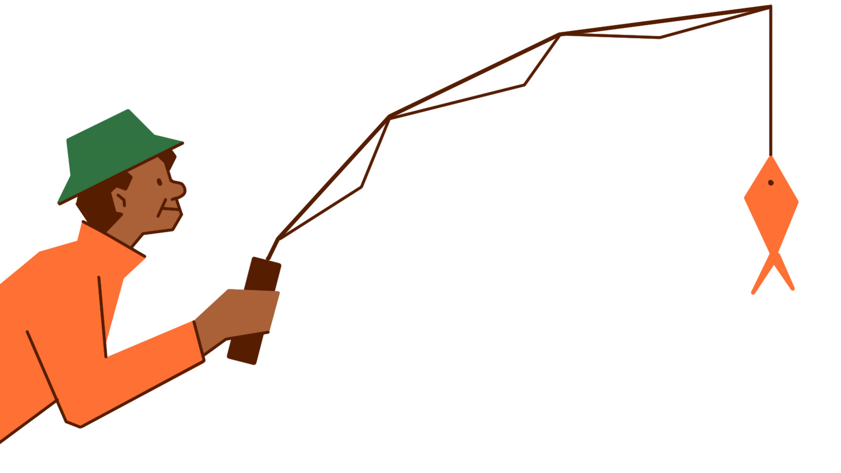
Haywood, A. et al. National Evaluation of the Preventing and Tackling Mental Ill Health through Green Social Prescribing Project. 2024. Defra.
Outcomes for people with mental health needs
One site collected physical activity data and showed a statistically significant improvement in people increasing their physical activity following a nature-based activity (from 84.2 per cent in the seven days before the activity to 94.7 per cent post activity).

Slide 12

Haywood, A. et al. National Evaluation of the Preventing and Tackling Mental Ill Health through Green Social Prescribing Project. 2024. Defra.
Understanding the value for money of the
Green Social Prescribing Project
Nature-based providers supported between 12 and 183 people depending on the level of resources they had, and the severity of mental health their project targeted.
The average cost per participant engaged in nature-based activities was £507 but costs ranged from £97 to £1,481.
The average cost per mental health or wellbeing outcome improvement was £619 with costs ranging from £225 to £1,777.
Compared with other interventions for people with mental health needs such as behavioural activation (£231- £250 for ten sessions), Cognitive Behavioural Therapy - CBT (£1,060 for ten sessions), early intervention for psychosis (£4,043 for the first year) and collaborative care for depression (£858 over six months), nature-based activities appear to be a relatively cost-efficient way to support people across a wide spectrum of mental health needs. It is important to recognise, however, that for many people, the most appropriate course of action to support their mental health will be to access different types of intervention in combination

Slide 13


Haywood, A. et al. National Evaluation of the Preventing and Tackling Mental Ill Health through Green Social Prescribing Project. 2024. Defra.
Understanding the value for money of the Green Social Prescribing Project
WELLBYs were used to estimate the value of improvements in individual life satisfaction experienced following participation in nature-based activities.
The central estimated value of WELLBYs created through the GSP Project was £14.0 million.
The estimated social return on investment of the GSP project was £2.42 per £1 invested by HM Treasury Shared Outcomes Fund and national partners. If resources leveraged by the Test and Learn sites are included, the social return on investment was estimated to be £1.88 of wellbeing for individual participants for every £1 invested in the project overall.

Slide 14
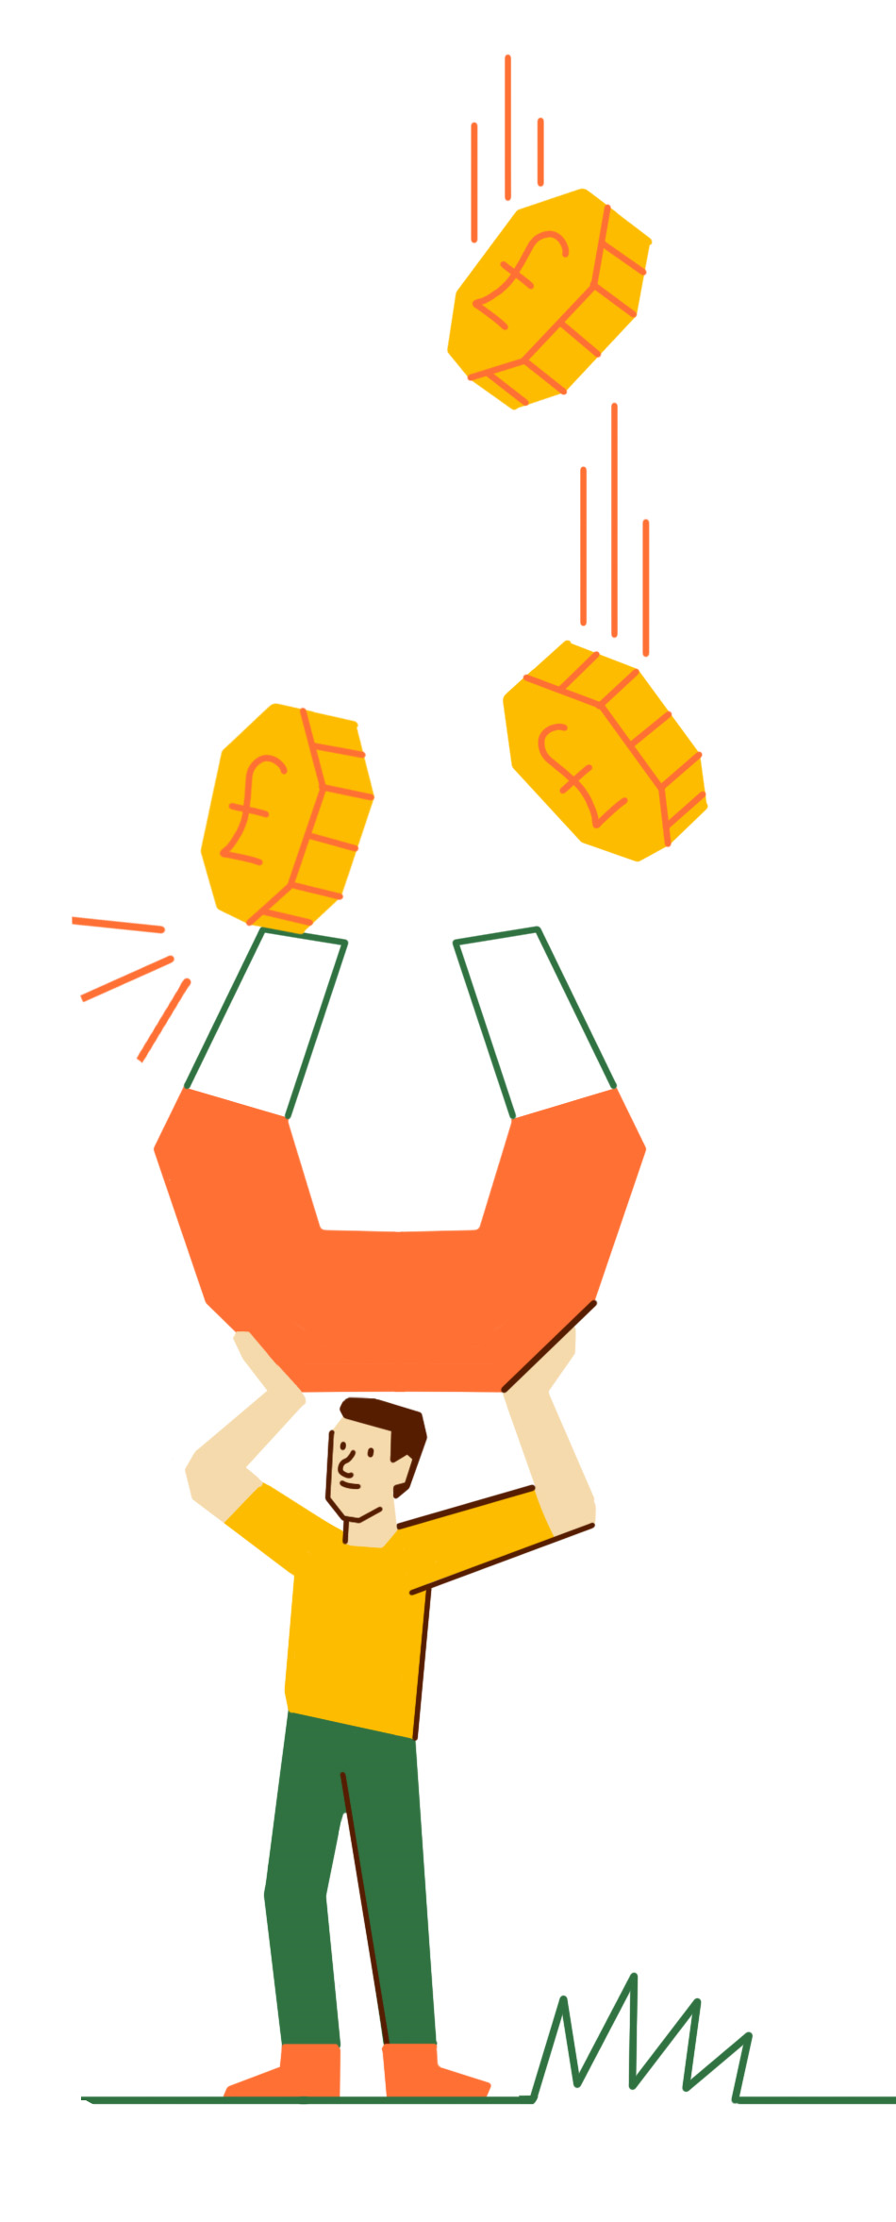
Haywood, A. et al. National Evaluation of the Preventing and Tackling Mental Ill Health through Green Social Prescribing Project. 2024. Defra.
Understanding the value for money of the
Green Social Prescribing Project
The £5.77m GSP project funding included £4.27 million from the HM Treasury Shared Outcomes Fund and £1.5 million from national partners.
The Test and Learn sites leveraged £1.66 million in matched funding (£1.48m) from public sector and philanthropic sources and in-kind resources (£0.18m) from local partners. They were also able to secure investment from their local health system and other sources worth £1.31m to continue their projects in 2023/24 after the Shared Outcomes Fund investment had ended.
When all of the matched funding and in-kind resources at a site level are combined, it amounts to an extra £2.98m, equating to an additional 52 pence (£0.52) for every pound (£1) invested in by the Shared Outcomes Fund and national partners and 85 pence (£0.85) for every pound (£1) directly invested at a site level.
The additional funding and resource brought to the GSP project by providers has an added value of 67 pence for every pound (£1) invested by the Test and Learn sites

Slide 15
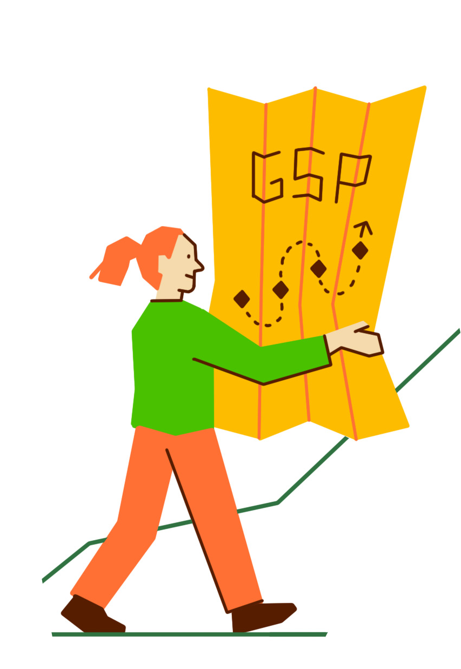
Haywood, A. et al. National Evaluation of the Preventing and Tackling Mental Ill Health through Green Social Prescribing Project. 2024. Defra.
Understanding the value for money of the
Green Social Prescribing Project
Based on the 8,339 people participating in nature-based activities through the GSP project, the cost per output (cost-efficiency) was £419 per person participating in nature-based activities.
This varied between sites from £223 to £4,201 reflecting the respective focus and activities undertaken by different projects.

Slide 16
Haywood, A. et al. National Evaluation of the Preventing and Tackling Mental Ill Health through Green Social Prescribing Project. 2024. Defra.
Key learning about how to scale and spread Green Social Prescribing
There is a need for new commissioning and procurement arrangements to ensure that nature-based providers can be embedded within health service delivery and the wider social prescribing landscape.
This requires ending precarious, short term and piecemeal funding for voluntary, community and social enterprise (VCSE) organisations.
The GSP Project demonstrated how advocacy, at different levels (local, regional, national), and co-designed approaches to addressing funding challenges, can lead to more joined-up commissioning processes that mean green providers can work together on funding bids

Slide 17
Haywood, A. et al. National Evaluation of the Preventing and Tackling Mental Ill Health through Green Social Prescribing Project. 2024. Defra.
Key learning about how to scale and spread Green Social Prescribing
When political and strategic influence is directed to support GSP it can lead to shifts in policy and budgeting.
Cross governmental commitment nationally has provided critical leadership support and funding for GSP.
Locally, GSP Project leaders have influenced local practices, systems and cultures and leveraged additional funding to support GSP.
There is now greater connection and understanding between parts of the system in relation to GSP, allowing priorities to become aligned and for power imbalances between sectors to be lessened.

Slide 18
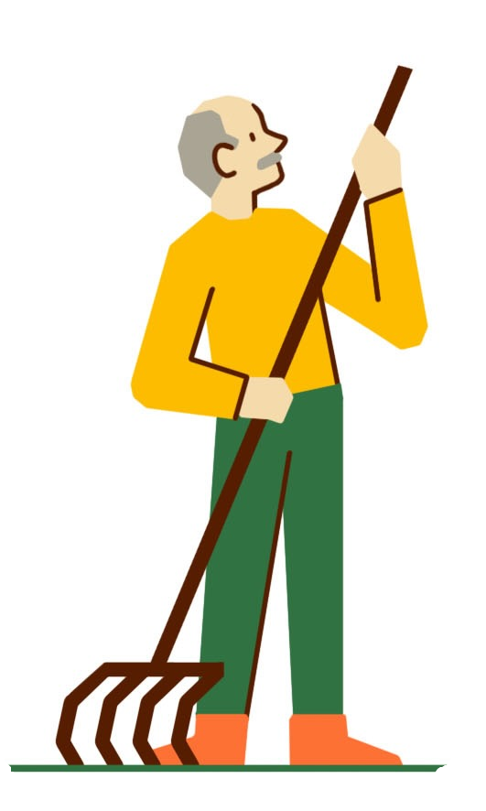

Haywood, A. et al. National Evaluation of the Preventing and Tackling Mental Ill Health through Green Social Prescribing Project. 2024. Defra.
Key learning about how to scale and spread Green Social Prescribing
It is necessary to grow and develop nature-based providers to ensure there are a range
of appropriate, diverse, geographically spread GSP opportunities.
Connectivity between nature-based providers and the social prescribing system (i.e., Link Workers) was sometimes limited, leading to low levels of referral.
This can be improved through better communication, targeted funding and investment for nature-based providers, co-design of referral pathways and the introduction and maintenance of “trusted provider” information resources.
Support for nature-based providers to work together to develop collective funding bids is also critical

Slide 19

Haywood, A. et al. National Evaluation of the Preventing and Tackling Mental Ill Health through Green Social Prescribing Project. 2024. Defra.
Key learning about how to scale and spread Green Social Prescribing
There is a need to remove barriers and create aligned structures, to ensure coherence and
clarity of roles and responsibilities across the system.
Multiple interdependencies are necessary for the GSP system to ‘work’.
The lack of alignment of ambitions, systems and processes poses challenges to delivery, and addressing these was a key component of all seven pilots.
Collaborations between relevant partners were built, and efforts made to clarify roles and responsibilities. Steps were taken to agree shared ambitions, ways of working and indicators of success.
However, some of the most important systemic misalignments such as sustainable funding and investment will take longer to address.

Slide 20

Haywood, A. et al. National Evaluation of the Preventing and Tackling Mental Ill Health through Green Social Prescribing Project. 2024. Defra.
Key learning about how to scale and spread Green Social Prescribing
Improvements to the gathering and sharing of data about GSP outputs and outcomes are necessary to build confidence in the efficacy of GSP.
There is a persistent perception at local and national level that evidence for GSP is not sufficiently compelling or rigorous and a lack of agreement around what evidence is needed.
The complexity of GSP poses multiple data collection challenges. Training, guidance, and payments to support data collection were provided but these challenges remained. It is likely that data collection and reporting will remain challenging for smaller VCSE organisations regardless of the support provided.
Technical solutions offer some hope and securing funding for these to be implemented consistently was seen as a vital milestone for some pilots.

Slide 21

Haywood, A. et al. National Evaluation of the Preventing and Tackling Mental Ill Health through Green Social Prescribing Project. 2024. Defra.
Key learning about how to scale and spread Green Social Prescribing
There is a need to improve information flow and feedback loops between providers, Link
Workers (LWs), referrers and funders to create more efficient and effective pathways.
Relationships between providers, Link Workers, referrers and funders can be fractured and dispersed, with reliance on key individuals. Participants can drop-out or disengage across social prescribing pathways if they are not appropriately supported.
The GSP project legitimised collaborative activity between the health and VCSE sector but in many cases referral feedback loops (between community and health services and back again) remained underdeveloped and reliant on personal relationships. Improving understanding and communicating about what levels of need can be supported by which activities was an important enabling factor along with ‘Active’ link working, where people are accompanied to the first session.

Slide 22

Haywood, A. et al. National Evaluation of the Preventing and Tackling Mental Ill Health through Green Social Prescribing Project. 2024. Defra.
Key learning about how to scale and spread Green Social Prescribing
Mutual accountability and shared problem solving is necessary to enhance service users’ experiences, but this requires trust and respect so that people understand and are aware of how different actors in the system may operate
Initially, there was a lack of mutual awareness and understanding between GSP partners, particularly between the NHS and VCSE sectors, leading to few referrals through formal SP referral routes and a lack of partnership working and coordination.
To overcome this the GSP Project invested in partnership activities including, co-design, provider networks, trusted provider schemes, taster sessions, training, and outreach to nature-based providers. Innovative funding approaches such as green health budgets were also explored.
Challenges to these activities’ success included limited capacity, balancing meaningful co-production with a need to ‘get things done’ in short timescales, building shared understanding, keeping provider lists and directories up to date, stretched LW capacity, and the complexity and severity of participant need.

Slide 23

Haywood, A. et al. National Evaluation of the Preventing and Tackling Mental Ill Health through Green Social Prescribing Project. 2024. Defra.
Key learning about how to scale and spread Green Social Prescribing
Building referrers’ capability, opportunity and motivation to refer to GSP will improve access to appropriate green opportunities.
At the start of the project, many pilots reported a lack of clarity around what activities were available to whom and how referrals could be made. LW provision is fragmented with multiple employers and little coordination or data sharing. LWs often were unaware of the specifics of GSP. Self-referral was the most common route to nature-based activities across all pilots.
Pilots provided training and taster sessions to increase awareness. Nature-based providers offered peer support, buddying, and befriending to support people to engage in activities, and pilots undertook work to understand specific needs and barriers.
However, LW capacity remains stretched, and support for alternative modes of referral - including self- and community-referral - will be important

Slide 24

Haywood, A. et al. National Evaluation of the Preventing and Tackling Mental Ill Health through Green Social Prescribing Project. 2024. Defra.
Key learning about how to scale and spread Green Social Prescribing
Equitable access to appropriate green opportunities requires decision making through an inequalities and instructional lens.
Not all nature-based activities are culturally appropriate or relevant for some communities and meaningfully engaging under-represented groups can be challenging, particularly when they do not have ready access to green spaces.
Pilots worked to harness existing local and national networks with strategic partners to explore approaches to tackling inequalities and target key groups. Dedicated activities and groups were established to meet the needs of diverse groups, including ethnic minority communities.
These efforts demonstrated that significant commitment and resources are needed to meaningfully explore inequalities in access and provision and facilitate meaningful engagement of people most likely to experience health inequalities.

Slide 25
Haywood, A. et al. National Evaluation of the Preventing and Tackling Mental Ill Health through Green Social Prescribing Project. 2024. Defra.
Key learning about how to scale and spread Green Social Prescribing
User voice can ensure green social prescribing is person-centred by illuminating the changes needed across the pathway.
The involvement of people with lived experience of mental ill health or service use was an ambition for all pilot sites, but involvement strategies appeared to be underdeveloped.
There were some examples of co-production and involvement, for example around funding decisions, and the inclusion of a person with lived experience on the national Partnership Board was novel. A small number of pilots involved people with lived experience in their design, delivery, and governance, and one included such people in the review and quality assurance process.
There was little resource to support involvement, and it is unclear the extent to which people actually influenced decision making.

Slide 26
Haywood, A. et al. National Evaluation of the Preventing and Tackling Mental Ill Health through Green Social Prescribing Project. 2024. Defra.
Key learning about how to scale and spread Green Social Prescribing
Ensuring service users have a positive experience across the GSP pathway is vital if numbers of referrals are to increase.
In each pilot there were examples of service users disengaging with GSP at different points of the social prescribing pathway. Barriers to engagement included poverty, a lack of access to transport or equipment, and deterioration in mental health status. These barriers may disproportionally affect marginalised groups.
Pilots worked to understand levels of participant need and potential barriers, providing tailored support, such as buddy schemes, and a consistent contact for users across the pathway. Practical barriers such as transport and kit/ equipment were addressed.
Training for nature based providers to support mental health referrals and recording the capability of providers to address different needs in directories, can help ensure referrals are made to appropriate providers.

Slide 27
Haywood, A. et al. National Evaluation of the Preventing and Tackling Mental Ill Health through Green Social Prescribing Project. 2024. Defra.
Reflections from the Green Social Prescribing National Partnership
Key learning for HMT and others undertaking large scale systems change projects similar to this are:
Guidance and good practice / learning for future projects would be helpful but getting the balance right and having enough of the right kinds of groups to facilitate good decisions and mutual understanding was important.
Central co-funding (rather than a single lead department) was perceived to be helpful to enable more effective cooperation and shared ownership of the project.
Time to clarify aims is needed for cross-government projects, rather than pressure to deliver and spend allocated budgets.
Recognition of the scale and nature of ‘systems change’ work and the need for two-way communication between localities and central government is important.
Early adoption and implementation of an appropriate evaluation that measures what is important and relevant to the ambitions of the project is vital.

Slide 28
Haywood, A. et al. National Evaluation of the Preventing and Tackling Mental Ill Health through Green Social Prescribing Project. 2024. Defra.
Evaluation methods
The evaluation was conducted in 2021-2023 by researchers from the Universities of Sheffield, Sheffield Hallam, Exeter and Plymouth. Mixed-methods, realist-informed evaluation methodology was used to assess processes and outcomes at the national and local levels, and improve understanding of what works, for whom, in what circumstances and why. The project consisted of seven interlinked work packages (WPs)
WP 1 Scoping: phase to design and develop the evaluation framework.
WP 2 Evidence synthesis and development of local theories of change.
WP 3 A mixed methods in-depth evaluation of the 7 Test and Learn sites:
  3A Quantitative data. Surveys and monitoring data.
  3B Qualitative data. Observational data, interview data.
WP 4 Light touch qualitative evaluation of non-test and learn sites.
WP 5 Qualitative evaluation of National Programme Partnership. Interviews and workshops.
WP 6 Value for money assessment.
WP 7 Integration of work packages and dissemination. Synthesis of WP 1-

Slide 29
Haywood, A. et al. National Evaluation of the Preventing and Tackling Mental Ill Health through Green Social Prescribing Project. 2024. Defra.
National Evaluation of the Preventing and Tackling Mental Ill Health through Green Social Prescribing Project
Suggested citation: Haywood, A., Dayson, C., Garside, R ., Foster, A ., Lovell, R ., Husk, K ., Holding, E ., Thompson, J ., Shearn, K ., Hunt, H.A ., Dobson, J ., Harris, C ., Jacques, R ., Witherley, D ., Northall, P ., Baumann, M ., Wilson, I . National Evaluation of the Preventing and Tackling Mental Ill Health through Green Social Prescribing Project. January 2024. Department for Environment, Food and Rural Affairs (London).
The accompanying briefing document, summary, full final report, and appendices, are published by Defra (Defra Project Code BE0191) and are available from the Department’s Science and Research Projects Database at https://randd.defra.gov.uk. Whilst the research was commissioned by Defra, the views expressed reflect the evaluation findings and the authors’ interpretation; they do not necessarily reflect Defra policy.

