Slide 1
Supplementary material: Participation in environmental enhancement and conservation activities for health and well-being in adults
From: Participation in environmental enhancement and conservation activities for health and well-being in adults. Husk et al. 2016 Cochrane Database of Systematic Reviews

Slide 2
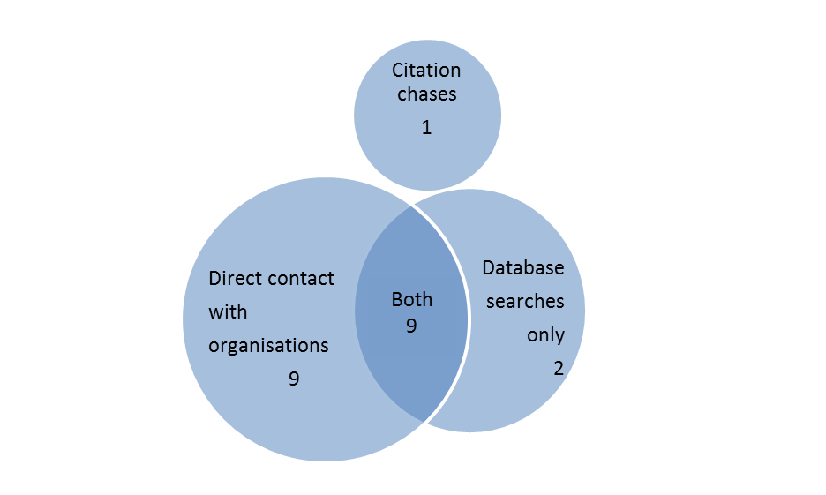
Location of studies
From: Participation in environmental enhancement and conservation activities for health and well-being in adults. Husk et al. 2016 Cochrane Database of Systematic Reviews

Slide 3
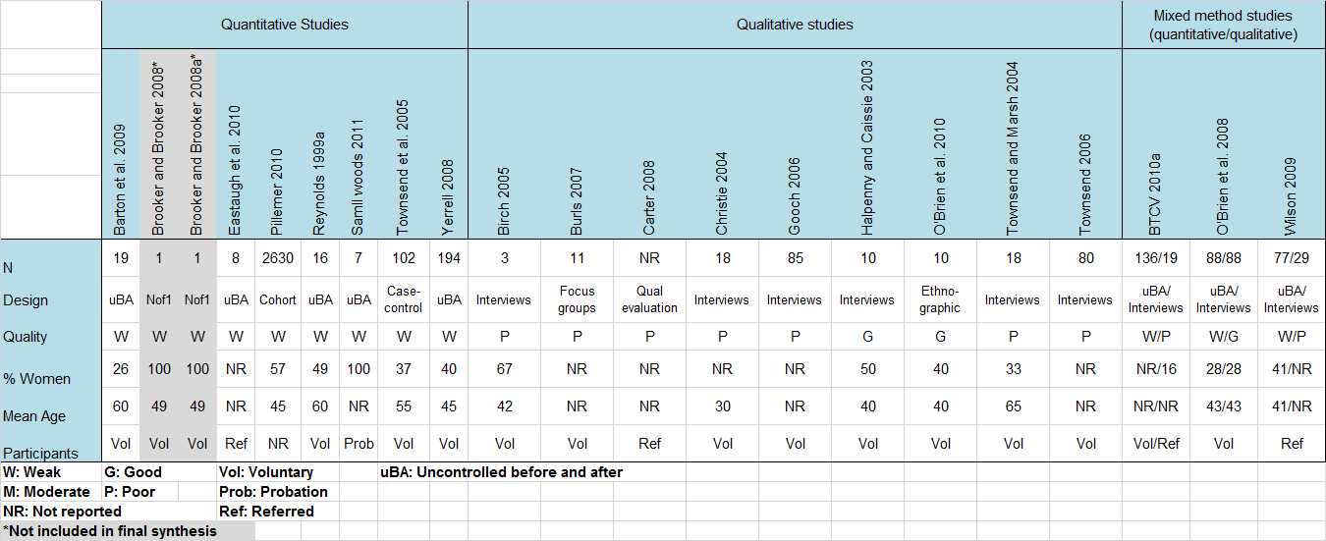
Participant characteristics
From: Participation in environmental enhancement and conservation activities for health and well-being in adults. Husk et al. 2016 Cochrane Database of Systematic Reviews

Slide 4
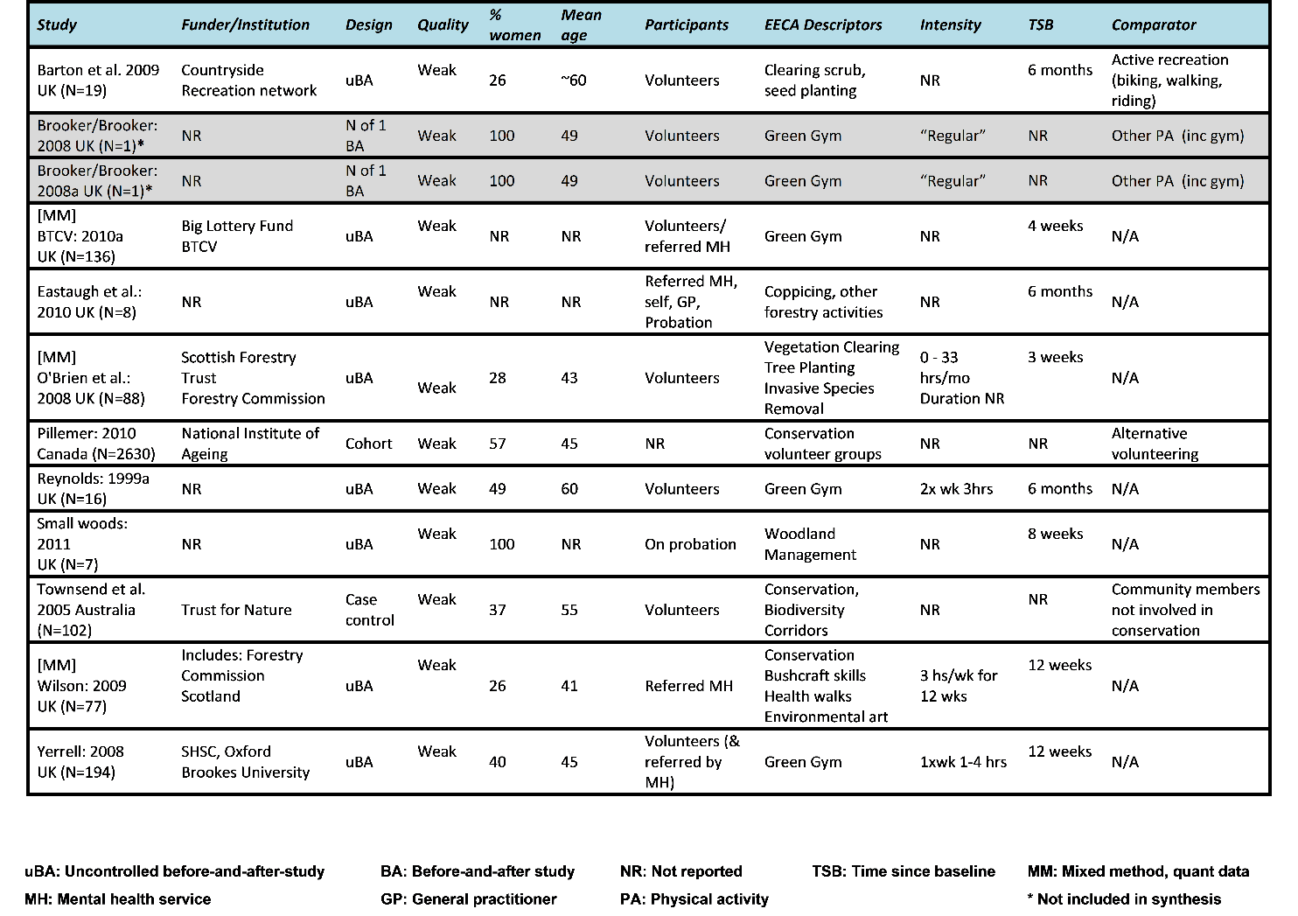
Quantitative data characteristics
From: Participation in environmental enhancement and conservation activities for health and well-being in adults. Husk et al. 2016 Cochrane Database of Systematic Reviews

Slide 5
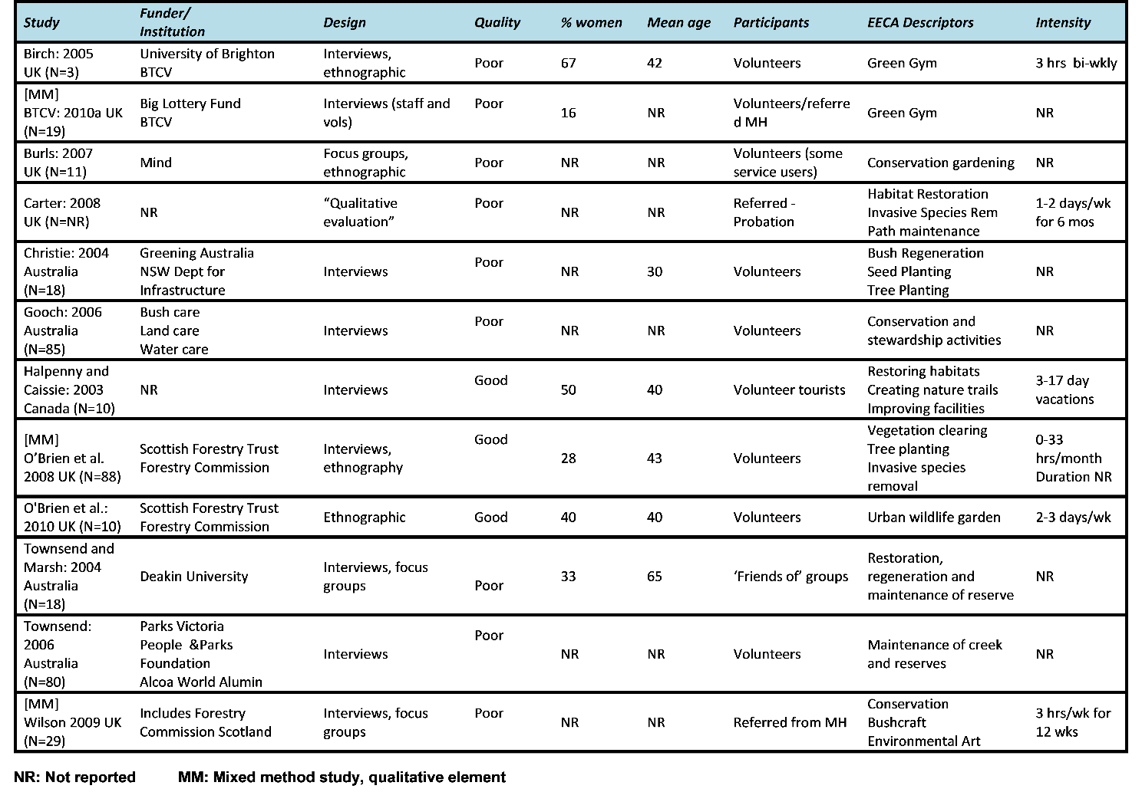
Qualitative characteristics
From: Participation in environmental enhancement and conservation activities for health and well-being in adults. Husk et al. 2016 Cochrane Database of Systematic Reviews

Slide 6
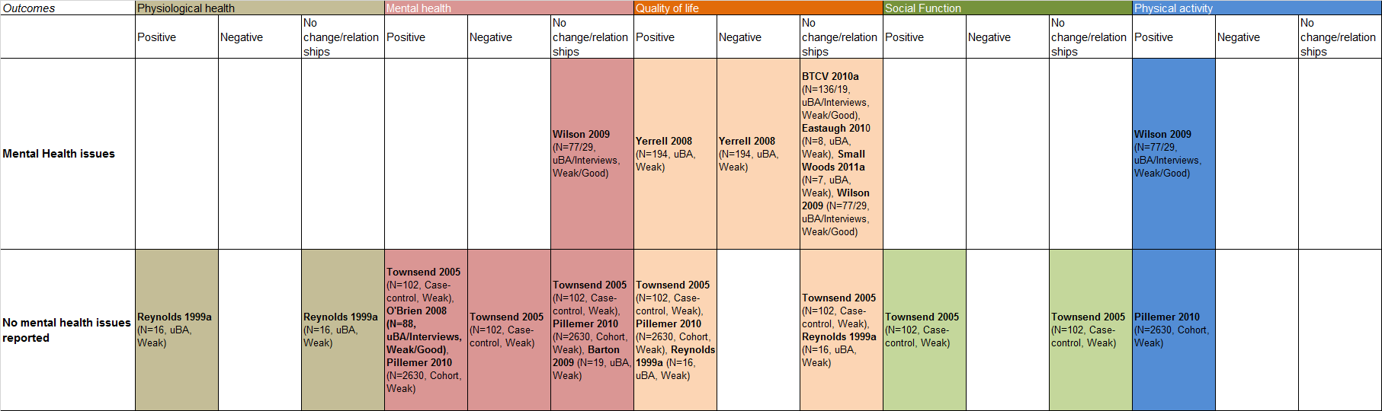
Sub group analysis – Mental health status
From: Participation in environmental enhancement and conservation activities for health and well-being in adults. Husk et al. 2016 Cochrane Database of Systematic Reviews

Slide 7
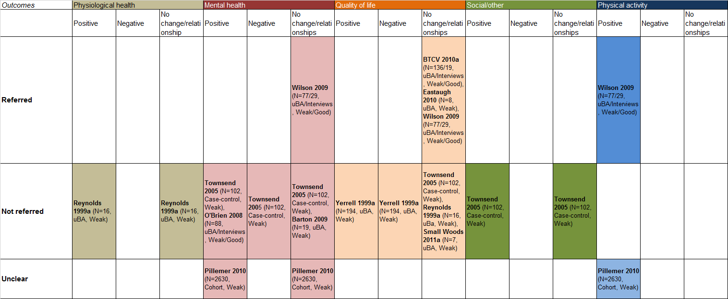
Sub group analysis – referral status
From: Participation in environmental enhancement and conservation activities for health and well-being in adults. Husk et al. 2016 Cochrane Database of Systematic Reviews

Slide 8
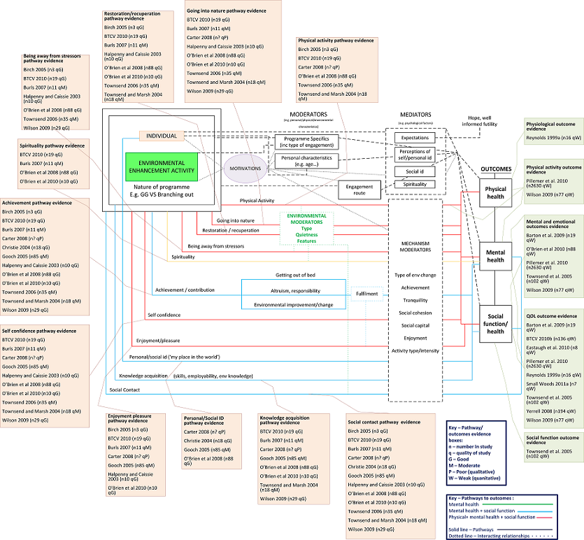
Interim conceptual framework
From: Participation in environmental enhancement and conservation activities for health and well-being in adults. Husk et al. 2016 Cochrane Database of Systematic Reviews

